Slide 1

50.039 Theory and Practice of Deep Learning W8-S1 The Embedding Problem
Matthieu De Mari

Slide 2
About this week (Week 8)
Why are embeddings an essential component of Neural Networks (NNs)?
Why are good embeddings difficult to produce?
What are the conventional approaches to embeddings in NLP? What can we learn from these approaches?
What are the typical issues with embeddings and how do we address them?
State-of-the-art of current embedding problems, and open questions in research.

Slide 3
About this week (Week 8)
How do we evaluate the quality/performance of an embedding?
Can embeddings be biased?
Can we help the neural networks identify the important parts of the context to focus on?
What is attention in Neural Networks? What are transformers in Neural Networks?
What are the typical uses for attention these days?
What are the limits of attention and the current research directions on this topic?

Slide 4
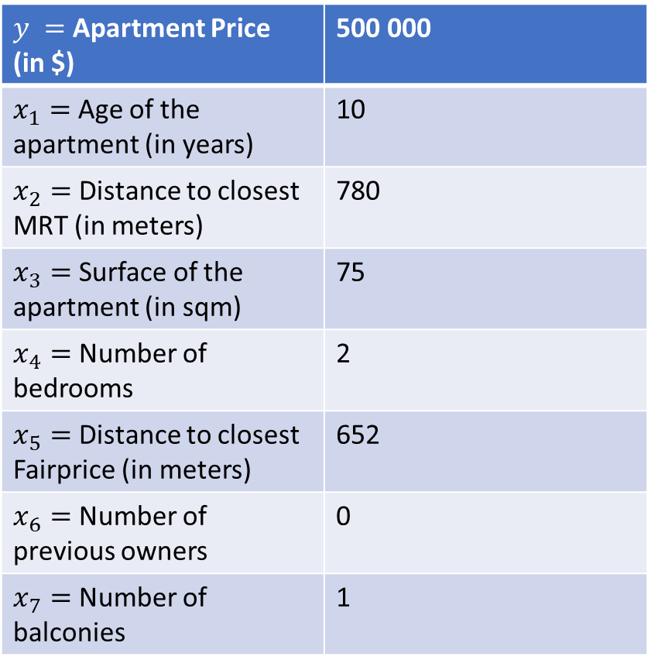
The embedding problem
$y =$Apartment Price (in $) | 500 000
$x_{1}=$ Age of the apartment (in years) | 10
$x_{2}=$ Distance to closest MRT (in meters) | 780
$x_{3}=$ Surface of the apartment (in sqm) | 75
$x_{4}=$ Number of bedrooms | 2
$x_{5}=$ Distance to closest Fairprice (in meters) | 652
$x_{6}=$ Number of previous owners | 0
$x_{7}=$ Number of balconies | 1
Definition (the embedding problem):
Neural Networks are designed to operate with tensors of numerical values (vectors, matrices, arrays, etc.). Our training process relies on processing numerical values, giving “sense/logic” to the Neural Network.
In some simple scenarios (nicely formatted data, images, etc.), inputs can be passed directly to a Neural Network, without modifications.

Slide 5
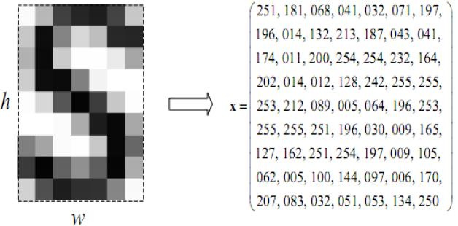

The embedding problem
Definition (the embedding problem):
Neural Networks are designed to operate with tensors of numerical values (vectors, matrices, arrays, etc.). Our training process relies on processing numerical values, giving “sense/logic” to the Neural Network.
In some simple scenarios (nicely formatted data, images, etc.), inputs can be passed directly to a Neural Network, without modifications.
CNN of some sort
$y=$index of the letter in the alphabet

Slide 6
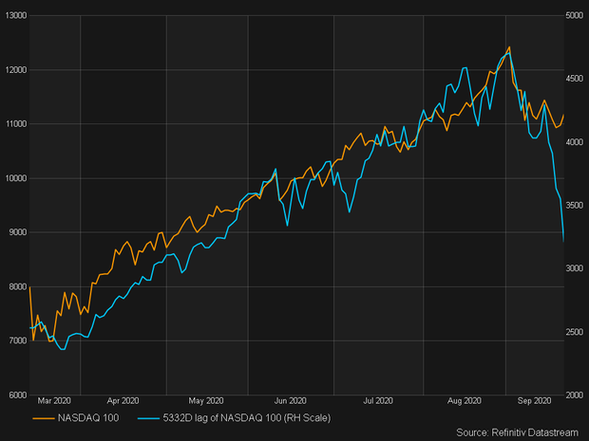
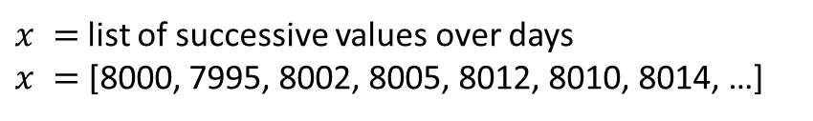
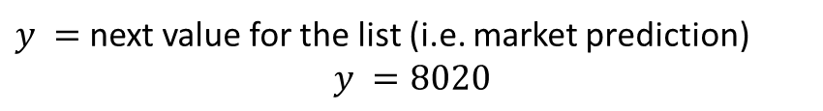
The embedding problem
Definition (the embedding problem):
Neural Networks are designed to operate with tensors of numerical values (vectors, matrices, arrays, etc.). Our training process relies on processing numerical values, giving “sense/logic” to the Neural Network.
In some simple scenarios (nicely formatted data, images, etc.), inputs can be passed directly to a Neural Network, without modifications.
$x =$list of successive values over days
$x =$ [8000, 7995, 8002, 8005, 8012, 8010, 8014, …]
RNN/TCN of some sort
$y =$next value for the list (i.e. market prediction)
$$y =8020$$

Slide 7


The embedding problem
Definition (the embedding problem):
Neural Networks are designed to operate with tensors of numerical values (vectors, matrices, arrays, etc.). Our training process relies on processing numerical values, giving “sense/logic” to the Neural Network.
When it comes to language, unfortunately, it is often the case that the data cannot be simply formatted as a tensor. That is the embedding problem.
But what if the input is a string of text (a word or a sentence)?
How do we convert text into numerical values?
“Hello”
$$x=?$$
“The quick brown fox jumps over the lazy dog”
$$x=?$$

Slide 8
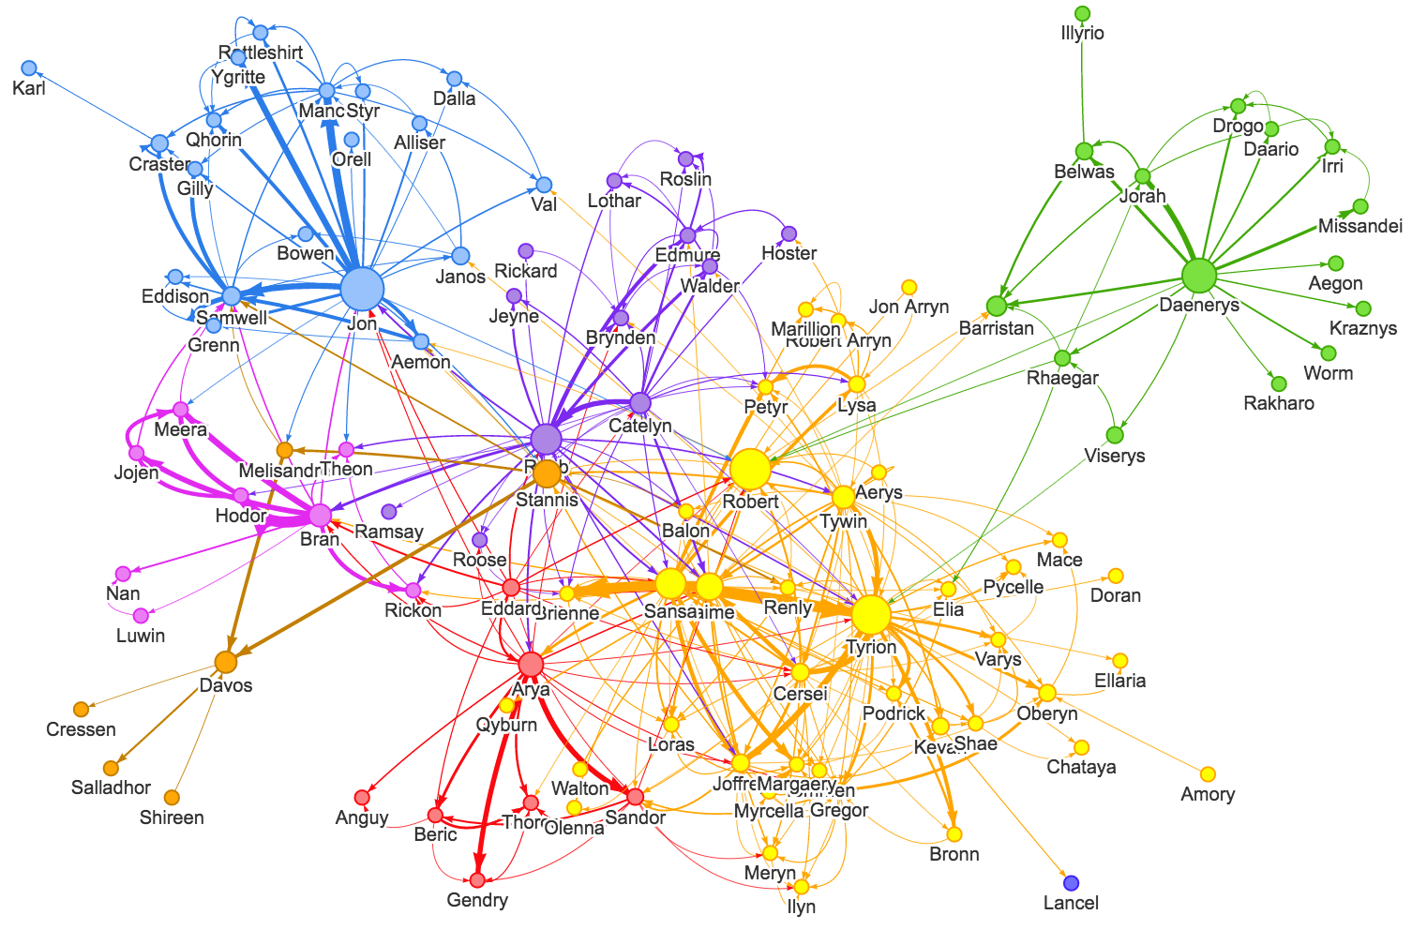

$$x=?$$

Slide 9


The embedding problem
Definition (the embedding problem):
Neural Networks are designed to operate with tensors (vectors, matrices, arrays, etc.) of numerical values. Our training process relies on processing numerical values, giving “sense/logic” to the Neural Network.
In many objects/data, it is often the case that the data cannot be simply formatted as a tensor. That is the embedding problem.
$$x=?$$

Slide 10

Let us start with a toy problem
Let us consider the following problem: the recommendation system from Netflix.
Our dataset is a list of movies, which can be watched on Netflix and that the user may have seen and/or liked.
Our objective is to suggest a recommendation of what our user would like to watch next.

Slide 11
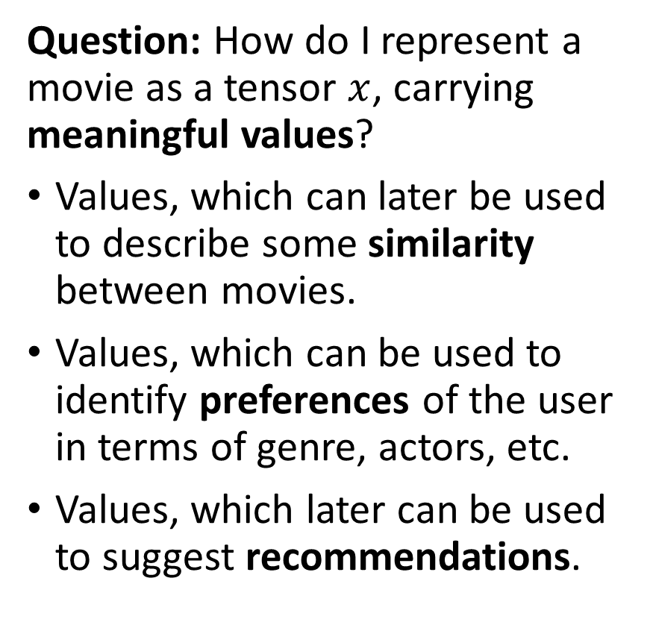
Let us start with a toy problem
Let us consider the following problem: the recommendation system from Netflix.
Our dataset is a list of movies, which can be watched on Netflix and that the user may have seen and/or liked.
Our objective is to suggest a recommendation of what our user would like to watch next.
Question: How do I represent a movie as a tensor $x$, carrying meaningful values?
Values, which can later be used to describe some similarity between movies.
Values, which can be used to identify preferences of the user in terms of genre, actors, etc.
Values, which later can be used to suggest recommendations.

Slide 12
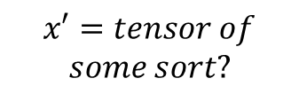
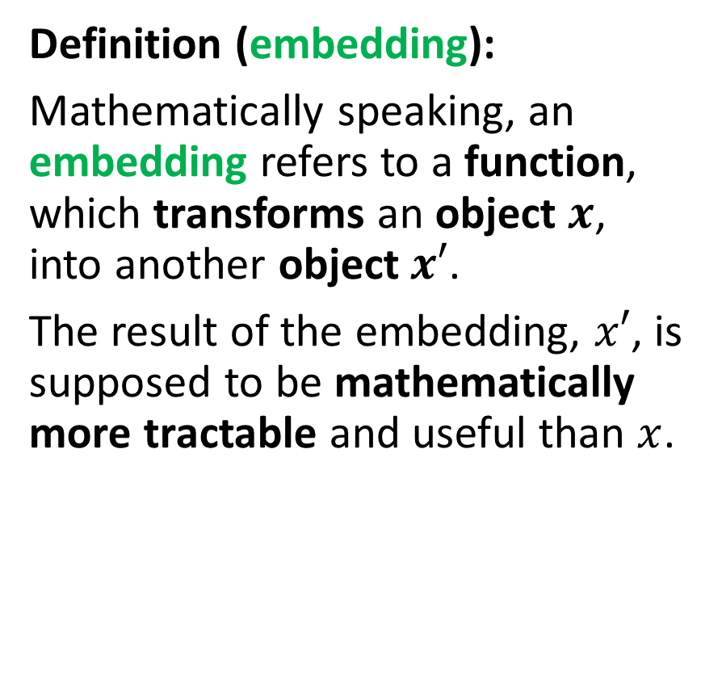

Embeddings, a mathematical definition
Definition (embedding):
Mathematically speaking, an embedding refers to a function, which transforms an object $x$, into another object$x′$.
The result of the embedding, $x′$, is supposed to be mathematically more tractable and useful than $x$.
Embeddings are typically used in Machine Learning to encode some non-mathematical data into a meaningful tensor, which can later be fed to a mathematical model (often a NN).
$$x=$$
$$x′=tensor of$$
$$some sort?$$

Slide 13
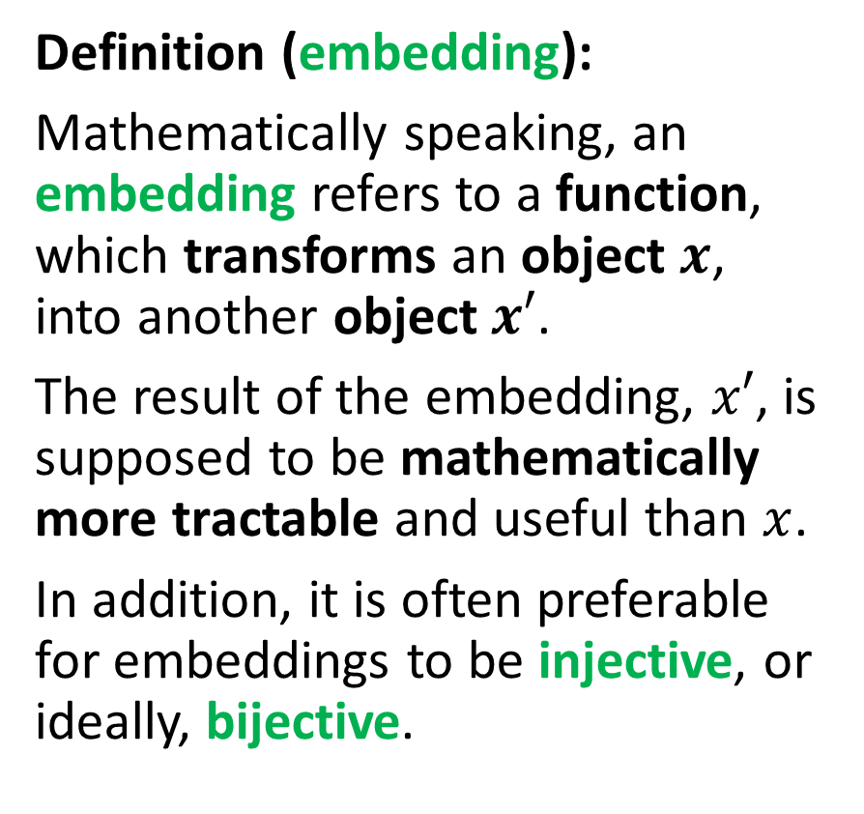
Embeddings, a mathematical definition
Definition (embedding):
Mathematically speaking, an embedding refers to a function, which transforms an object $x$, into another object$x′$.
The result of the embedding, $x′$, is supposed to be mathematically more tractable and useful than $x$.
In addition, it is often preferable for embeddings to be injective, or ideally, bijective.
Embeddings are typically used in Machine Learning to encode some non-mathematical data into a meaningful tensor, which can later be fed to a mathematical model (often a NN).
$$x=$$
$$x′=tensor of$$
$$some sort?$$

Slide 14
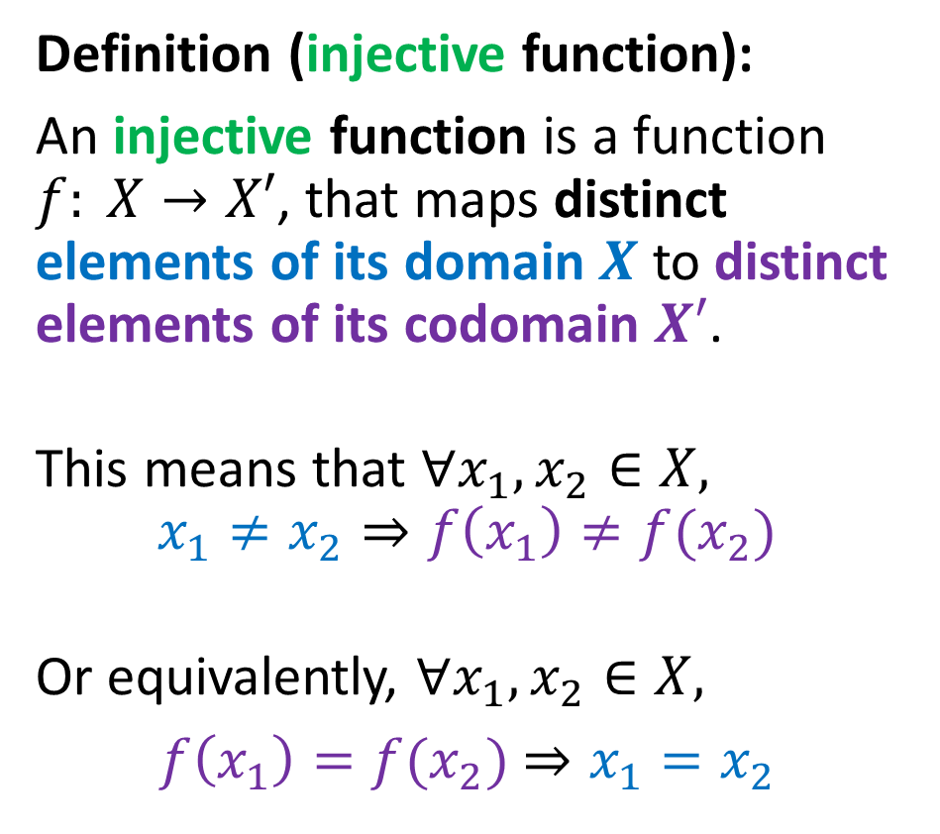
Embeddings, a mathematical definition
Definition (embedding):
Mathematically speaking, an embedding refers to a function, which transforms an object $x$, into another object$x′$.
The result of the embedding, $x′$, is supposed to be mathematically more tractable and useful than $x$.
In addition, it is often preferable for embeddings to be injective, or ideally, bijective.
Definition (injective function):
An injective function is a function $f: X→X′$, that maps distinct elements of its domain $X$ to distinct elements of its codomain $X′$.
This means that $∀x_{1},x_{2}∈X,$
$$x_{1}≠x_{2}⇒f\left(x_{1}\right)≠f(x_{2})$$
Or equivalently, $∀x_{1},x_{2}∈X,$
$f\left(x_{1}\right)=f(x_{2})$ $⇒x_{1}=x_{2}$

Slide 15
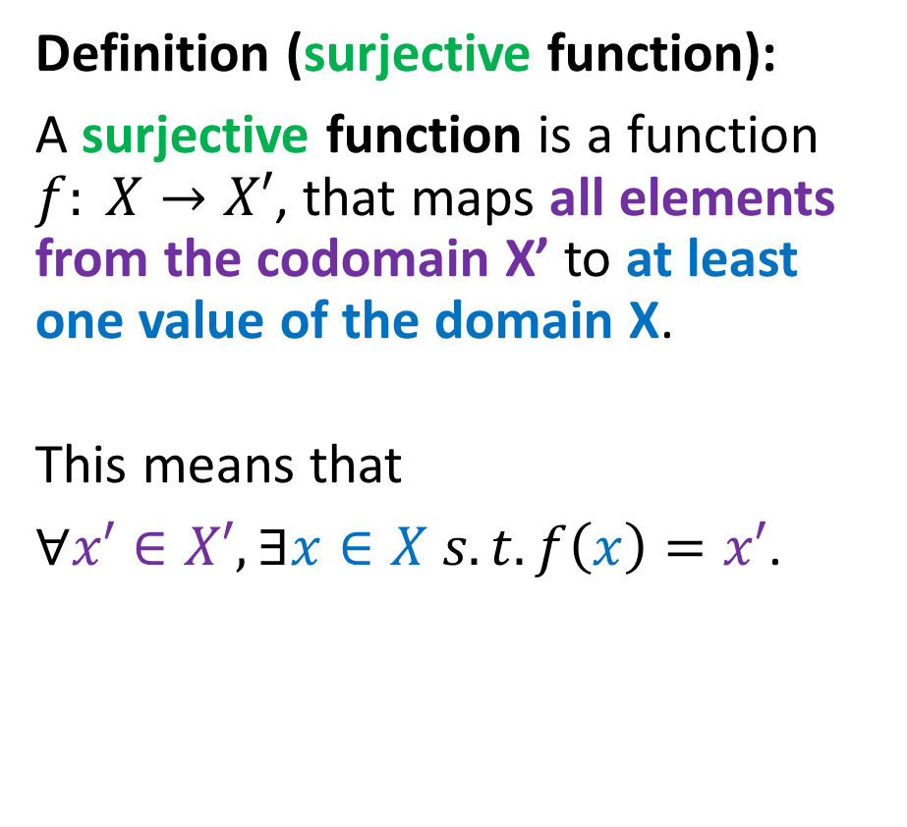
Embeddings, a mathematical definition
Definition (embedding):
Mathematically speaking, an embedding refers to a function, which transforms an object $x$, into another object$x′$.
The result of the embedding, $x′$, is supposed to be mathematically more tractable and useful than $x$.
In addition, it is often preferable for embeddings to be injective, or ideally, bijective.
Definition (surjective function):
A surjective function is a function $f: X→X′$, that maps all elements from the codomain X’ to at least one value of the domain X.
This means that
$∀x′∈X′, ∃x∈X s.t. f\left(x\right)=x′$.

Slide 16
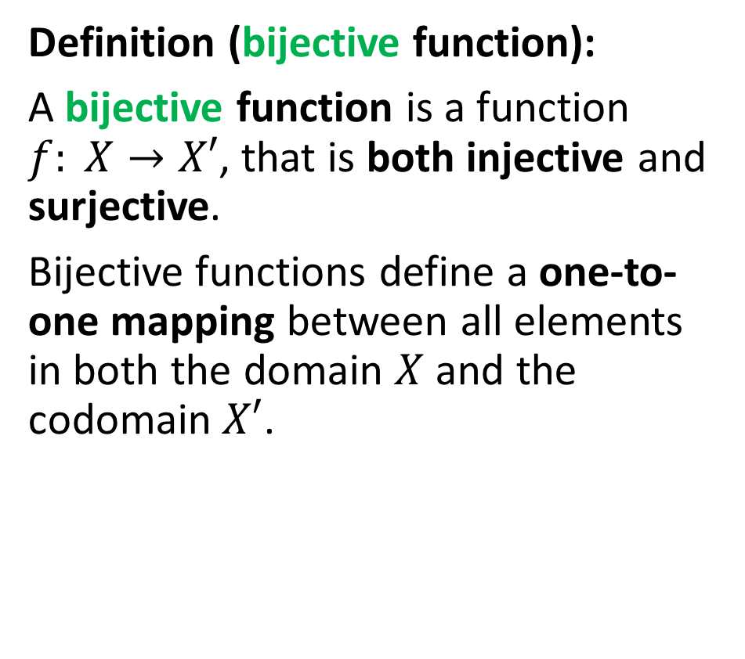
Embeddings, a mathematical definition
Definition (embedding):
Mathematically speaking, an embedding refers to a function, which transforms an object $x$, into another object$x′$.
The result of the embedding, $x′$, is supposed to be mathematically more tractable and useful than $x$.
In addition, it is often preferable for embeddings to be injective, or ideally, bijective.
Definition (bijective function):
A bijective function is a function $f: X→X′$, that is both injective and surjective.
Bijective functions define a one-to-one mapping between all elements in both the domain $X$ and the codomain $X′$.

Slide 17

Injective, surjective and bijective functions

Slide 18
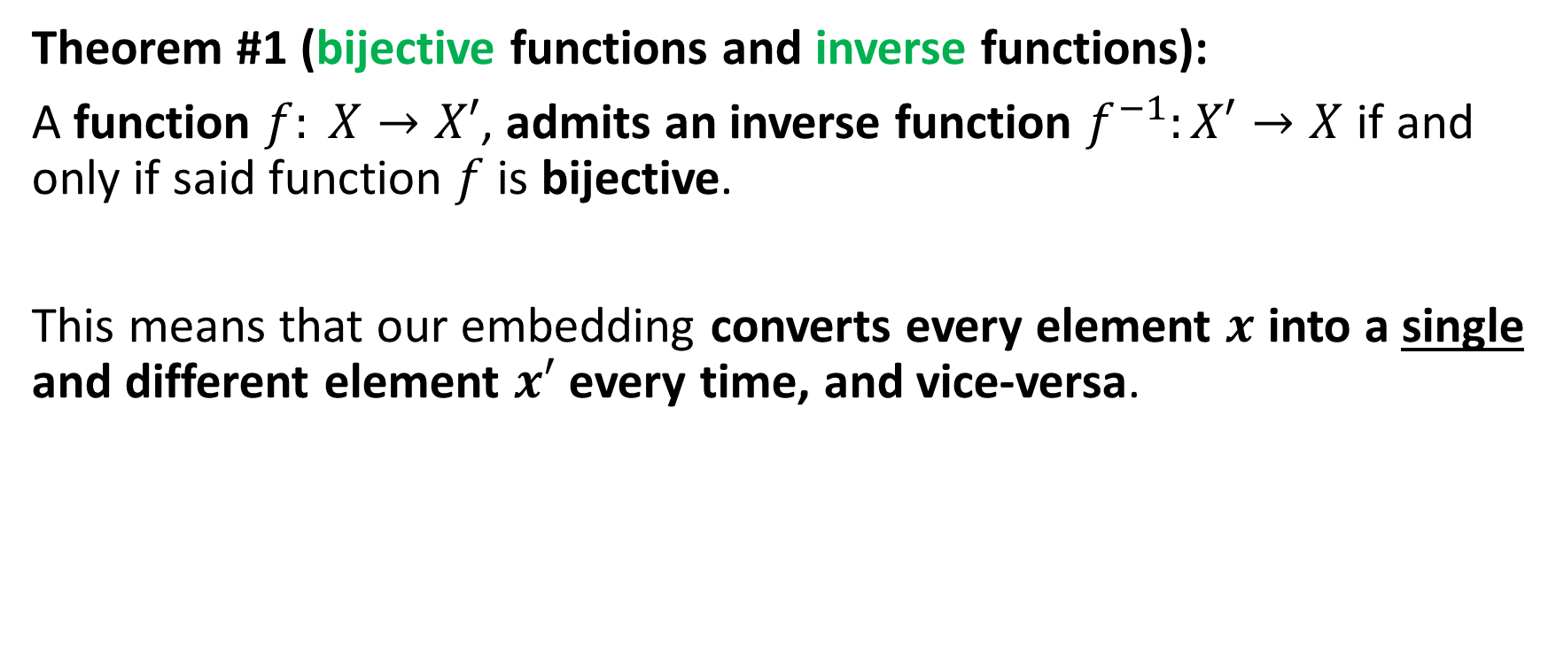
Embeddings, a mathematical definition
Theorem #1 (bijective functions and inverse functions):
A function $f: X→X′$, admits an inverse function $f^{−1}:X′→X$ if and only if said function $f$ is bijective.
This means that our embedding converts every element $x$ into a single and different element $x′$ every time, and vice-versa.

Slide 19
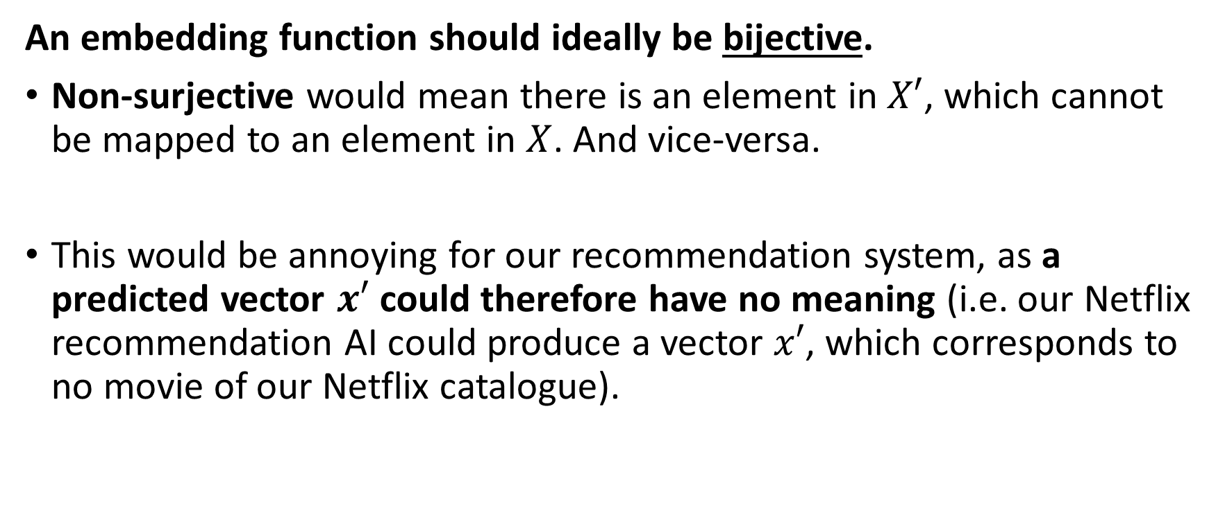
Embeddings, a mathematical definition
An embedding function should ideally be bijective.
Non-surjective would mean there is an element in $X′$, which cannot be mapped to an element in $X$. And vice-versa.
This would be annoying for our recommendation system, as a predicted vector $x′$ could therefore have no meaning (i.e. our Netflix recommendation AI could produce a vector $x′$, which corresponds to no movie of our Netflix catalogue).

Slide 20
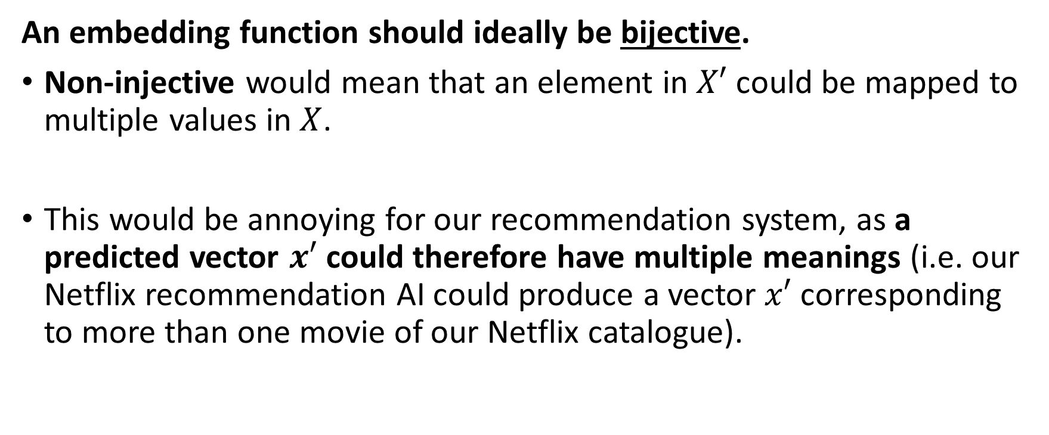
Embeddings, a mathematical definition
An embedding function should ideally be bijective.
Non-injective would mean that an element in $X′$ could be mapped to multiple values in $X$.
This would be annoying for our recommendation system, as a predicted vector $x′$ could therefore have multiple meanings (i.e. our Netflix recommendation AI could produce a vector $x′$ corresponding to more than one movie of our Netflix catalogue).

Slide 21
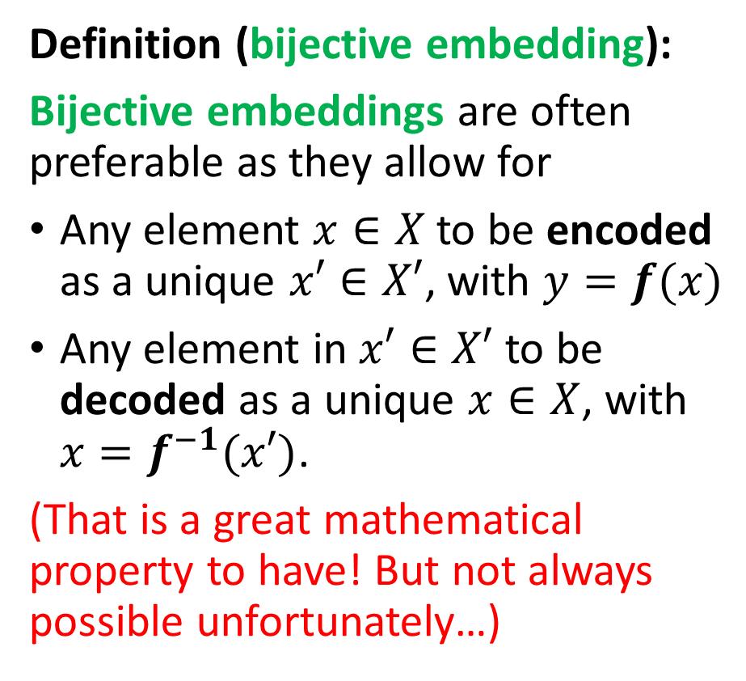
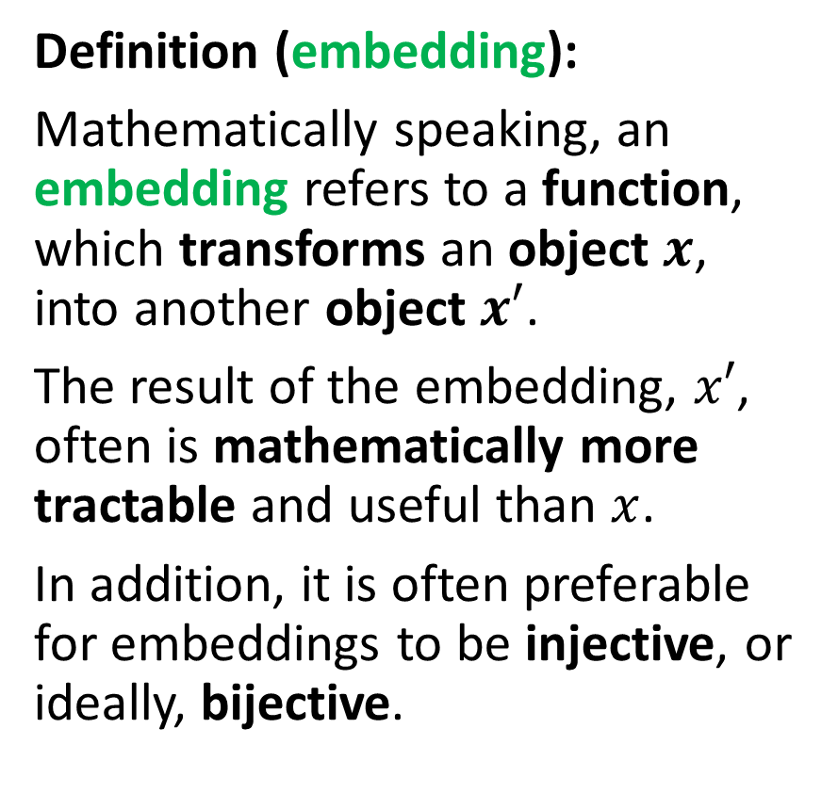
Embeddings, a mathematical definition
Definition (embedding):
Mathematically speaking, an embedding refers to a function, which transforms an object $x$, into another object $x′$.
The result of the embedding, $x′$, often is mathematically more tractable and useful than $x$.
In addition, it is often preferable for embeddings to be injective, or ideally, bijective.
Definition (bijective embedding):
Bijective embeddings are often preferable as they allow for
Any element $x∈X$to be encoded as a unique $x′∈X′$, with $y=f(x)$
Any element in $x′∈X′$ to be decoded as a unique $x∈X$, with $x=f^{−1}(x′)$.
(That is a great mathematical property to have! But not always possible unfortunately…)

Slide 22
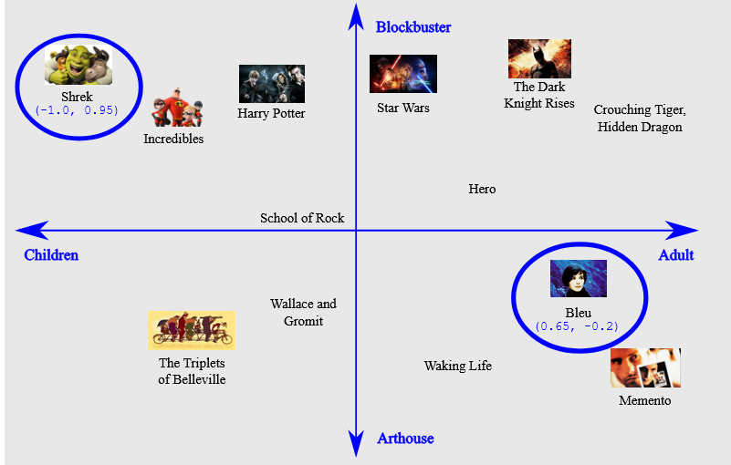
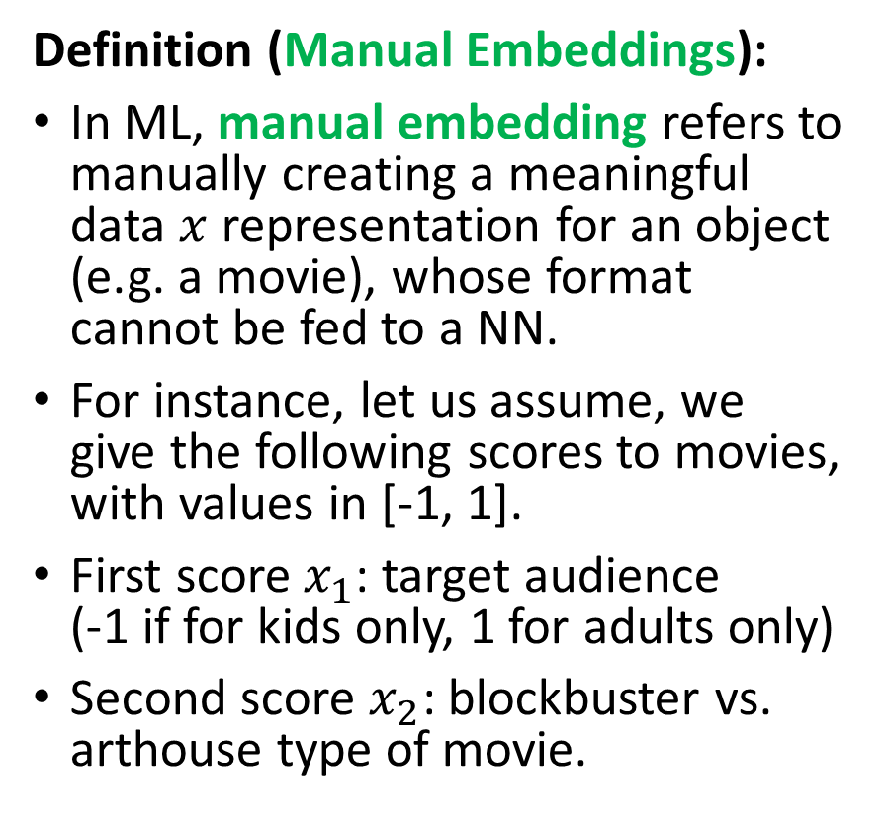
Manual embedding
Definition (Manual Embeddings):
In ML, manual embedding refers to manually creating a meaningful data $x$ representation for an object (e.g. a movie), whose format cannot be fed to a NN.
For instance, let us assume, we give the following scores to movies, with values in [-1, 1].
First score $x_{1}$: target audience (-1 if for kids only, 1 for adults only)
Second score $x_{2}$: blockbuster vs. arthouse type of movie.

Slide 23
Manual embedding
Using this manual embedding, we can then train a binary classifier to classify unseen movies, based what the user has previously watched and liked/not liked.
We could even rank these preferences by, e.g. computing some distance to the boundary.
✓
X
✓
?
?
✓
X
✓
X
X
In general, however, we would prefer an automated process → How could we train a model to learn a proper embedding to use for a given task/data format?

Slide 24
The embedding problem, in language
A typical scenario where embedding appears necessary, has to do with language, or as we call it in the DL community: Natural Language Processing (NLP).
Deep Learning architectures are incapable of processing strings or plain text in their raw form.
And language is… a bit of a pain to embed, for multiple reasons…
Let us see why through some examples.
Word $x$ (e.g. $x = “cat”$)
Word 𝑥 (e.g. 𝑥 = “𝑐𝑎𝑡”)
Embedding function $f$
Embedding function 𝑓
Word Embedding $$x′= f\left(x\right)$$
(e.g. $x′= (0.2, 0, 4.7, 2.8, 1,…)$)
Word Embedding 𝑥′= 𝑓(𝑥)
(e.g. 𝑥′= (0.2, 0, 4.7, 2.8, 1,…))

Slide 25
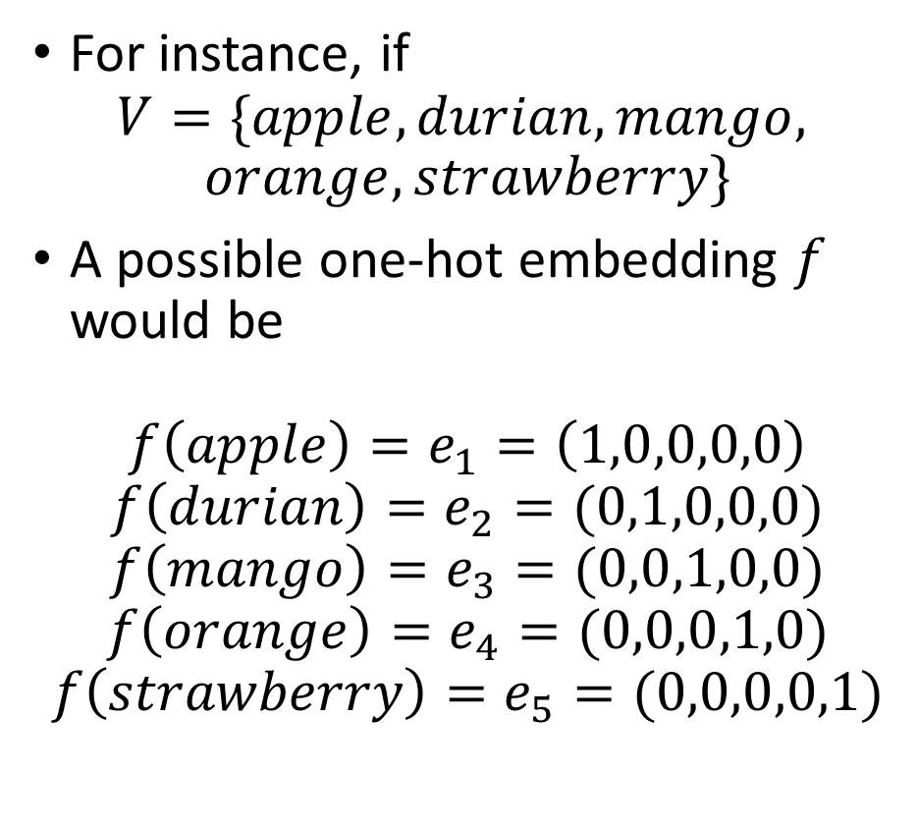
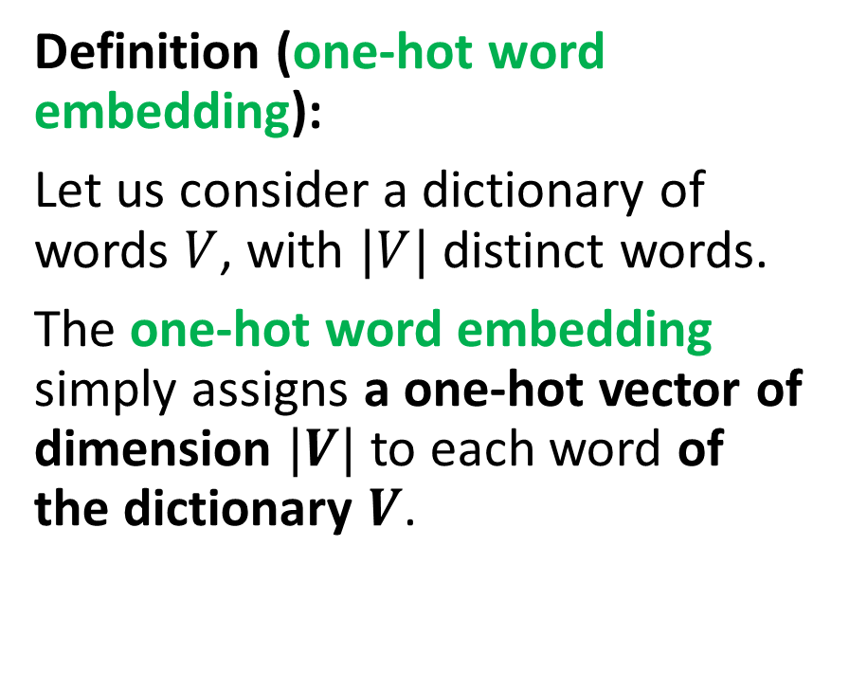
A simple word embedding
Definition (one-hot word embedding):
Let us consider a dictionary of words $V$, with $|V|$distinct words.
The one-hot word embedding simply assigns a one-hot vector of dimension $|V|$to each word of the dictionary $V$.
For instance, if
$$V=\{apple, durian, mango,$$
$$orange, strawberry\}$$
A possible one-hot embedding $f$ would be
$$f\left(apple\right)=e_{1}=\left(1,0,0,0,0\right)$$
$$f\left(durian\right)=e_{2}=(0,1,0,0,0)$$
$$f\left(mango\right)=e_{3}=(0,0,1,0,0)$$
$$f\left(orange\right)=e_{4}=(0,0,0,1,0)$$
$$f\left(strawberry\right)=e_{5}=(0,0,0,0,1)$$

Slide 26
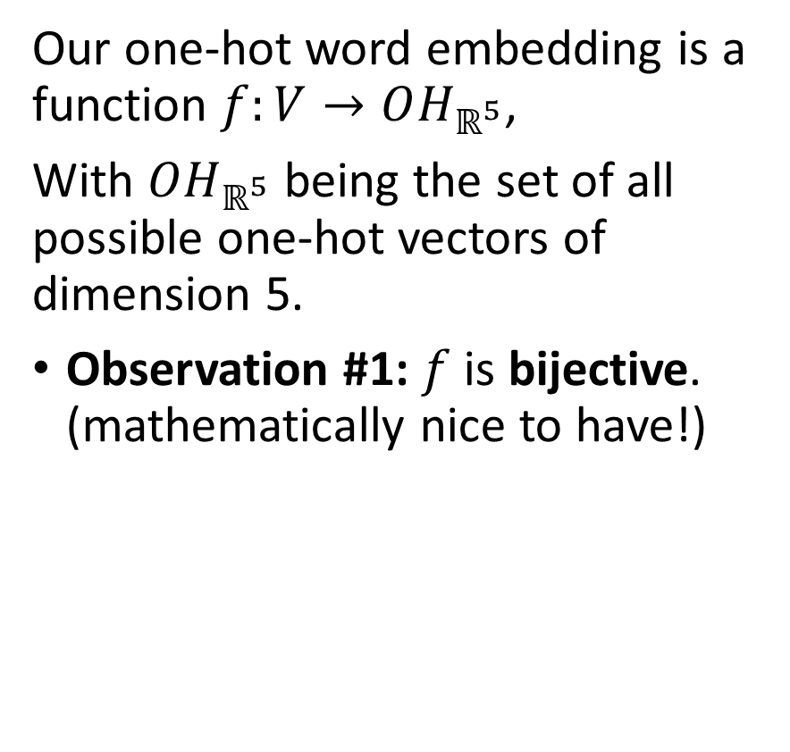

A simple word embedding
Definition (one-hot word embedding):
Let us consider a dictionary of words $V$, with $|V|$distinct words.
The one-hot word embedding simply assigns a one-hot vector of dimension $|V|$to each word of the dictionary $V$.
Our one-hot word embedding is a function $f:V→OH_{ℝ^{5}}$,
With $OH_{ℝ^{5}}$ being the set of all possible one-hot vectors of dimension 5.
Observation #1: $f$ is bijective. (mathematically nice to have!)

Slide 27
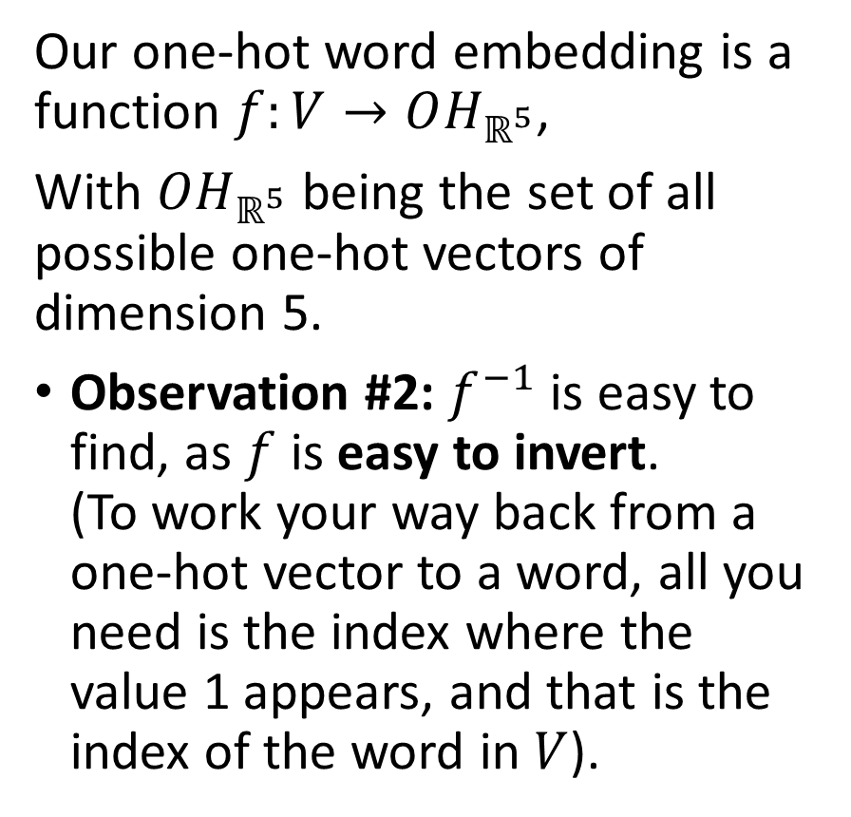
A simple word embedding
Definition (one-hot word embedding):
Let us consider a dictionary of words $V$, with $|V|$distinct words.
The one-hot word embedding simply assigns a one-hot vector of dimension $|V|$to each word of the dictionary $V$.
Our one-hot word embedding is a function $f:V→OH_{ℝ^{5}}$,
With $OH_{ℝ^{5}}$ being the set of all possible one-hot vectors of dimension 5.
Observation #2: $f^{−1}$ is easy to find, as $f$ is easy to invert. (To work your way back from a one-hot vector to a word, all you need is the index where the value 1 appears, and that is the index of the word in $V$).

Slide 28
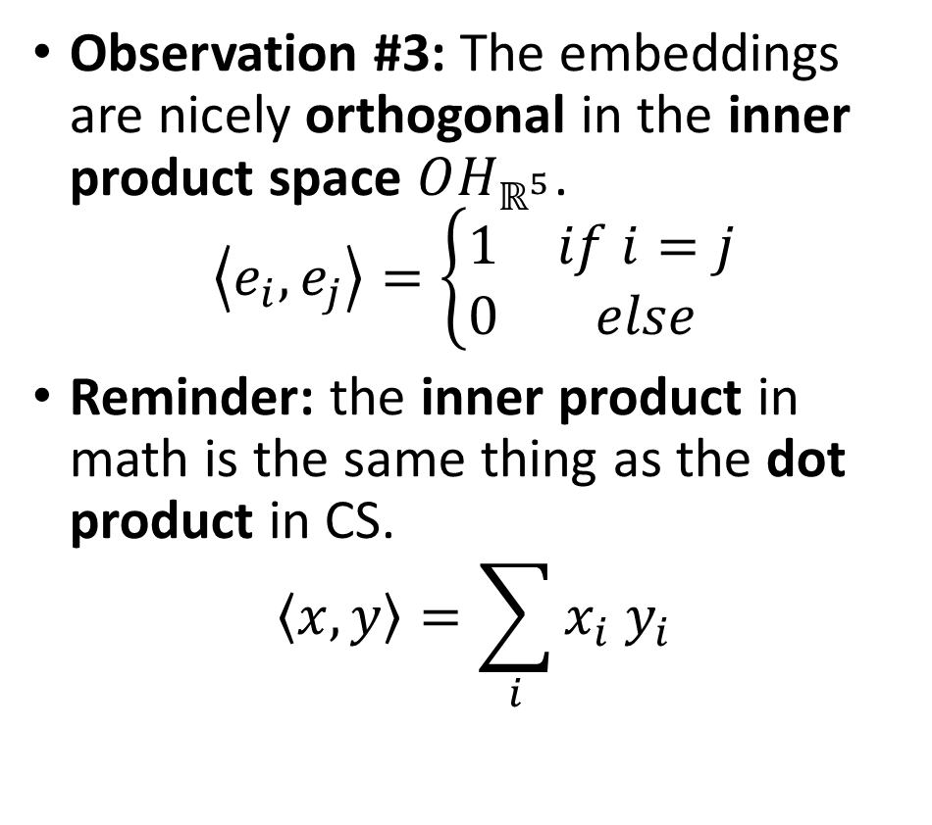
A simple word embedding
Definition (one-hot word embedding):
Let us consider a dictionary of words $V$, with $|V|$distinct words.
The one-hot word embedding simply assigns a one-hot vector of dimension $|V|$to each word of the dictionary $V$.
Observation #3: The embeddings are nicely orthogonal in the inner product space $OH_{ℝ^{5}}$.
$$\left\langle e_{i}, e_{j}\right\rangle =\left\{\begin{matrix}1 & if i=j \\ 0 & else\end{matrix}\right.$$
Reminder: the inner product in math is the same thing as the dot product in CS.
$$\left\langle x, y\right\rangle =\sum_{i}{x_{i}{ y}_{i}}$$

Slide 29
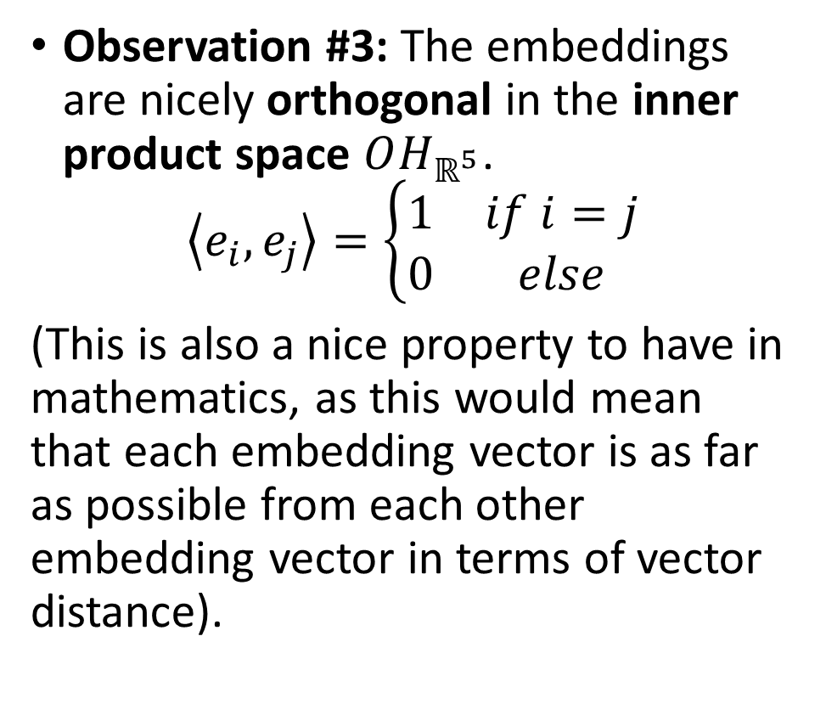
A simple word embedding
Definition (one-hot word embedding):
Let us consider a dictionary of words $V$, with $|V|$distinct words.
The one-hot word embedding simply assigns a one-hot vector of dimension $|V|$to each word of the dictionary $V$.
Observation #3: The embeddings are nicely orthogonal in the inner product space $OH_{ℝ^{5}}$.
$$\left\langle e_{i}, e_{j}\right\rangle =\left\{\begin{matrix}1 & if i=j \\ 0 & else\end{matrix}\right.$$
(This is also a nice property to have in mathematics, as this would mean that each embedding vector is as far as possible from each other embedding vector in terms of vector distance).

Slide 30
The embedding problem, in language
A typical scenario where embedding appears necessary, has to do with language, or as we call it in the DL community: Natural Language Processing (NLP).
And language is… a (bit of a) pain to embed, for multiple reasons…
The one-hot word embedding, while simple and mathematically convenient, unfortunately suffers from many problems and will not work well in the case of language…
Problems that have to do with the logic behind human language.

Slide 31

The embedding problem, in language
Problem #1: Identical words can have multiple (and sometimes very different) meanings.
In fact, this meaning is often decided by the surrounding words in the sentence, which provide context, not by the word on its own.
I ate a club sandwich yesterday.
I broke my golf club yesterday night.

Slide 32
The embedding problem, in language
Problem #1: Identical words can have multiple (and sometimes very different) meanings.
In fact, this meaning is often decided by the surrounding words in the sentence, which provide context, not by the word on its own.
For that reason, the embedding vector should intrinsically carry this difference in terms of meaning for the NN to use.
This cannot happen if we use a naïve one-hot vectors embedding representation.
Reason: two identical words with different meanings would have the same embedding vector.
I ate a club sandwich yesterday.
I broke my golf club yesterday night.

Slide 33

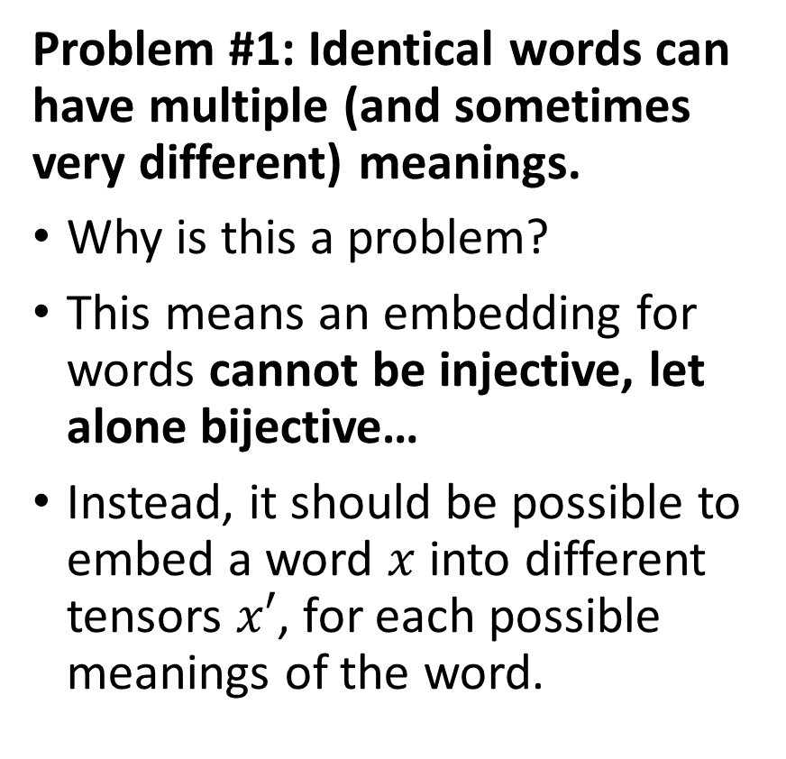
The embedding problem, in language
$x^{′}=f(\text{x}\text{ = }\text{club})$ will have different possible outputs based on context?
Word “club”
Context
Embedding vector for “club” as in a nightclub
Embedding vector for “club” as in a club sandwich
Etc.
Problem #1: Identical words can have multiple (and sometimes very different) meanings.
Why is this a problem?
This means an embedding for words cannot be injective, let alone bijective…
Instead, it should be possible to embed a word $x$ into different tensors $x′$, for each possible meanings of the word.

Slide 34
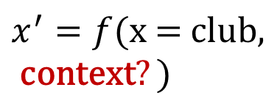
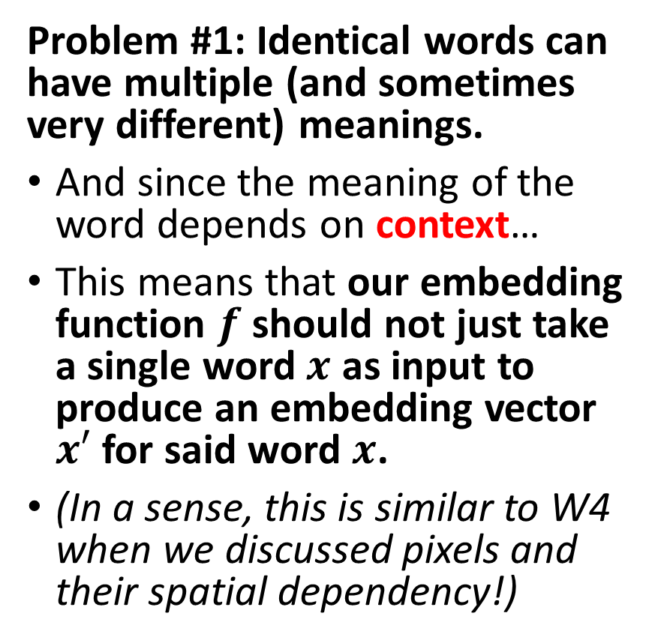
The embedding problem, in language
Word “club”
Context
Embedding vector for “club” as in a nightclub
Embedding vector for “club” as in a club sandwich
Etc.
Problem #1: Identical words can have multiple (and sometimes very different) meanings.
And since the meaning of the word depends on context…
This means that our embedding function $f$ should not just take a single word $x$ as input to produce an embedding vector $x′$ for said word $x$.
(In a sense, this is similar to W4 when we discussed pixels and their spatial dependency!)
$$x^{′}=f(\text{x}\text{ = }\text{club}\text{,} \\ \text{context}?)$$

Slide 35

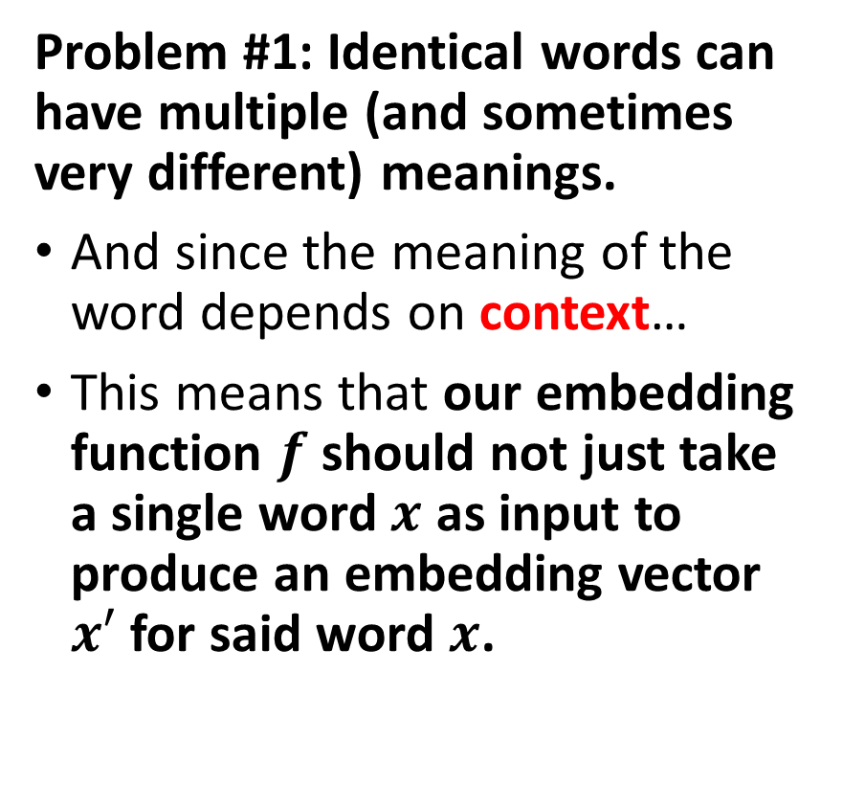
The embedding problem, in language
Problem #1: Identical words can have multiple (and sometimes very different) meanings.
And since the meaning of the word depends on context…
This means that our embedding function $f$ should not just take a single word $x$ as input to produce an embedding vector $x′$ for said word $x$.
This is what our one-hot embedding simply does with words.
$f:V→$ $OH_{ℝ^{m}}$
$$f\left(club\right)=\left(0, 0, …,0,1,0,…,0\right)=e_{k}$$
I ate a club sandwich yesterday.
I broke my golf club yesterday night.

Slide 36
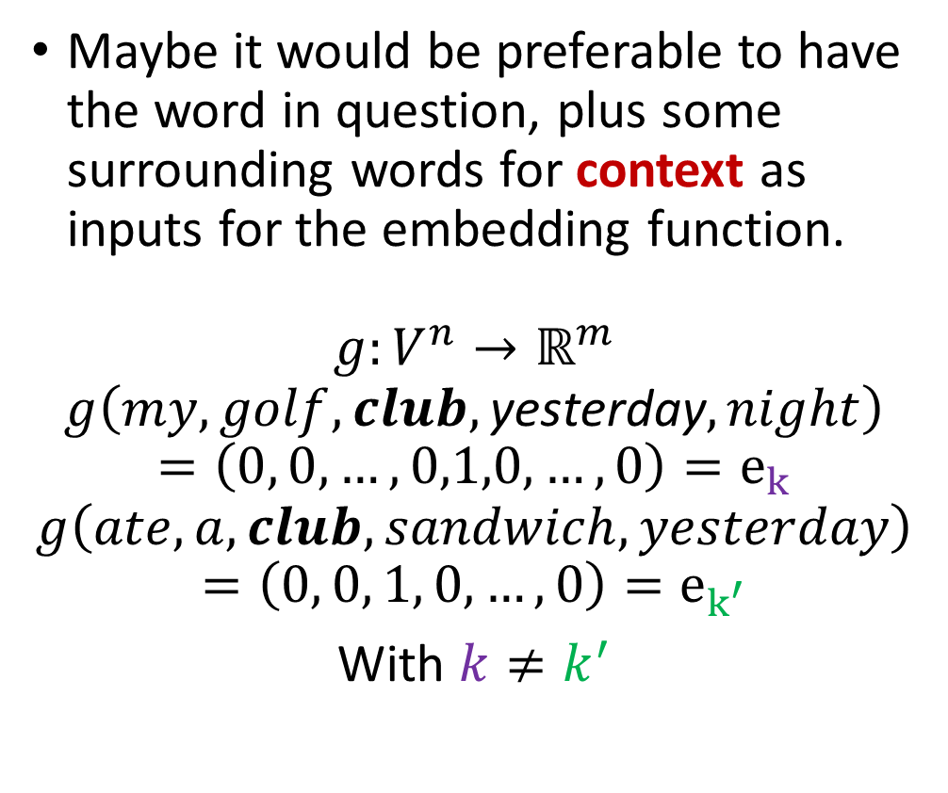
The embedding problem, in language
Problem #1: Identical words can have multiple (and sometimes very different) meanings.
And since the meaning of the word depends on context…
This means that our embedding function $f$ should not just take a single word $x$ as input to produce an embedding vector $x′$ for said word $x$.
Maybe it would be preferable to have the word in question, plus some surrounding words for context as inputs for the embedding function.
$$g:V^{n}→ℝ^{m}$$
$$g\left(my, golf, club,\text{yesterday}, night\right)$$
$$=\left(0, 0, …,0,1,0,…,0\right)=e_{k}$$
$$g\left(ate, a, club,sandwich, yesterday\right)$$
$$=\left(0, 0, 1, 0,…,0\right)=e_{k^{′}}$$
With $k≠k^{′}$
I ate a club sandwich yesterday.
I broke my golf club yesterday night.

Slide 37
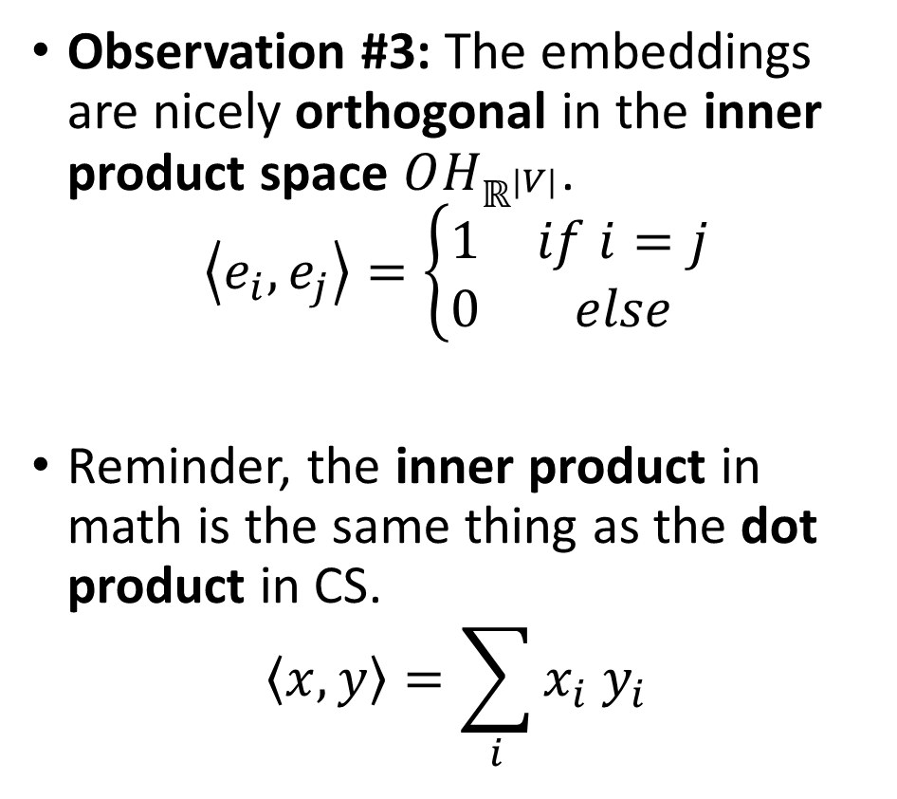
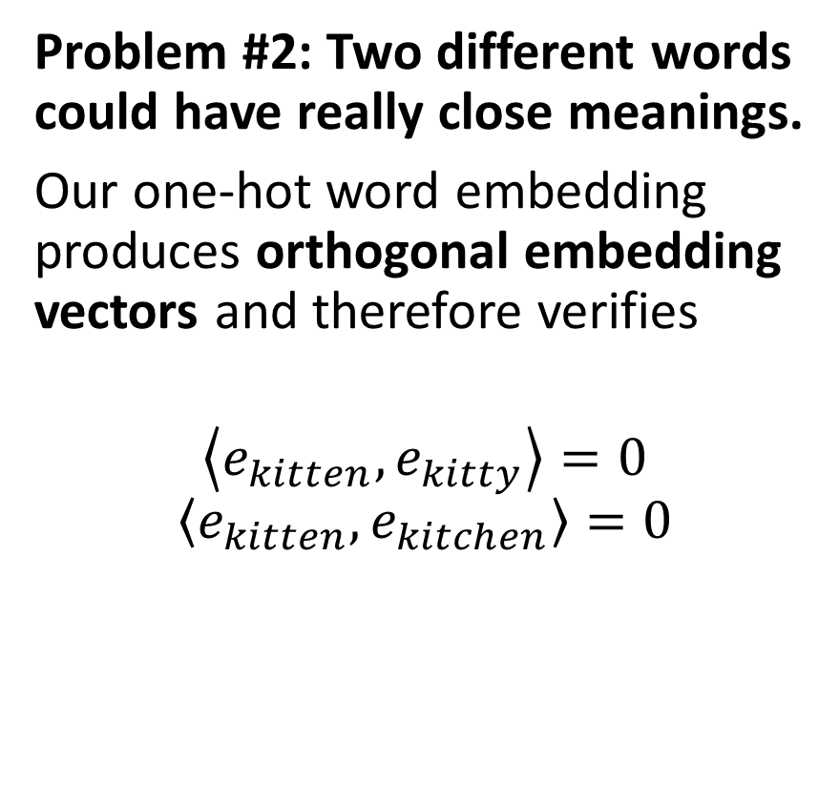
The embedding problem, in language
Problem #2: Two different words could have really close meanings.
Our one-hot word embedding produces orthogonal embedding vectors and therefore verifies
$$\left\langle e_{kitten}, e_{kitty}\right\rangle =0$$
$$\left\langle e_{kitten}, e_{kitchen}\right\rangle =0$$
Observation #3: The embeddings are nicely orthogonal in the inner product space $OH_{ℝ^{|V|}}$.
$$\left\langle e_{i}, e_{j}\right\rangle =\left\{\begin{matrix}1 & if i=j \\ 0 & else\end{matrix}\right.$$
Reminder, the inner product in math is the same thing as the dot product in CS.
$$\left\langle x, y\right\rangle =\sum_{i}{x_{i}{ y}_{i}}$$

Slide 38
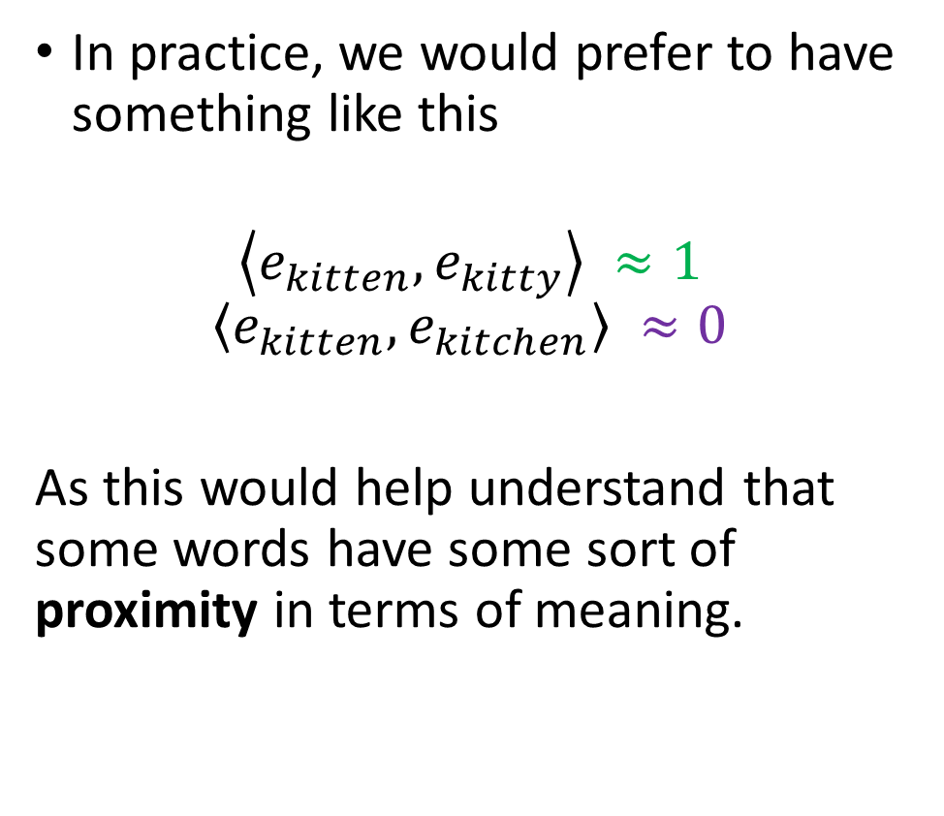
The embedding problem, in language
Problem #2: Two different words could have really close meanings.
Our one-hot word embedding produces orthogonal embedding vectors and therefore verifies
$$\left\langle e_{kitten}, e_{kitty}\right\rangle =0$$
$$\left\langle e_{kitten}, e_{kitchen}\right\rangle =0$$
In practice, we would prefer to have something like this
$$\left\langle e_{kitten}, e_{kitty}\right\rangle ≈1$$
$$\left\langle e_{kitten}, e_{kitchen}\right\rangle ≈0$$
As this would help understand that some words have some sort of proximity in terms of meaning.

Slide 39
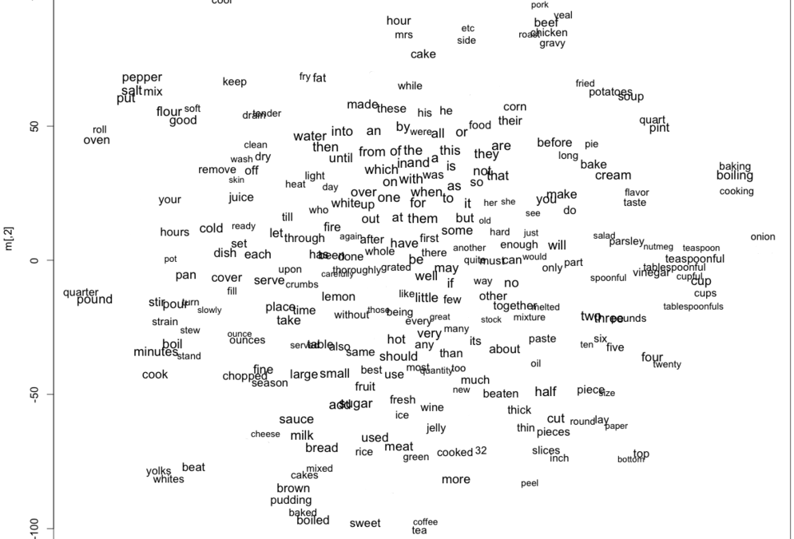


The embedding problem, in language
Problem #2: Two different words could have really close meanings.
Our one-hot word embedding typically verifies
$$\left\langle e_{kitten}, e_{kitty}\right\rangle =0$$
$$\left\langle e_{kitten}, e_{kitchen}\right\rangle =0$$
In practice, we would prefer to have something like this
$$\left\langle e_{kitten}, e_{kitty}\right\rangle ≈1$$
$$\left\langle e_{kitten}, e_{kitchen}\right\rangle ≈0$$
As this would help understand that some words have proximity.
And we would expect that the embeddings for words with similar meaning would tend to cluster together…!

Slide 40
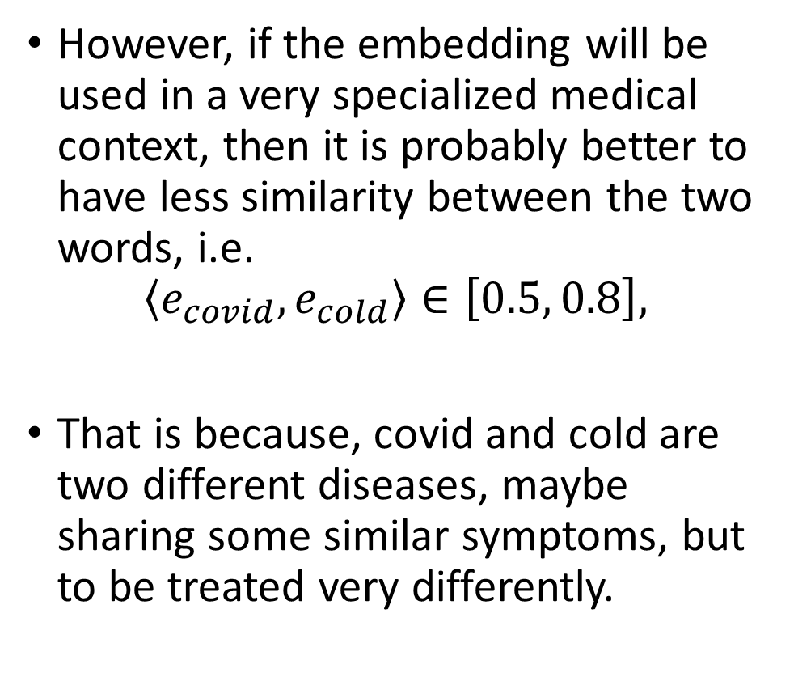
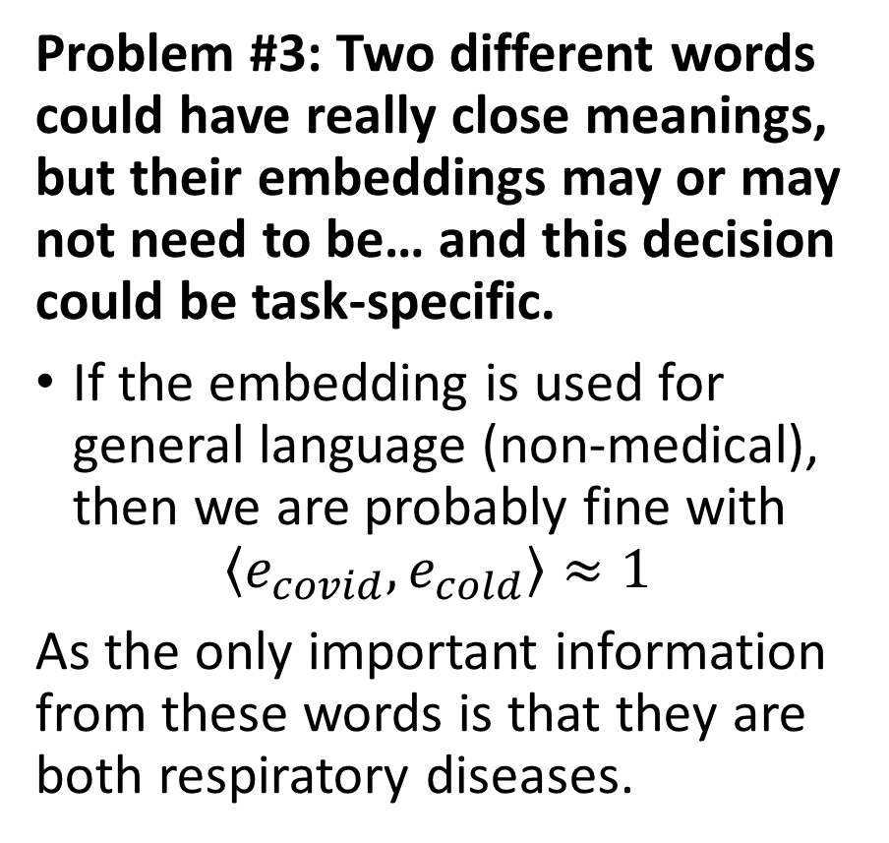
The embedding problem, in language
Problem #3: Two different words could have really close meanings, but their embeddings may or may not need to be… and this decision could be task-specific.
If the embedding is used for general language (non-medical), then we are probably fine with
$$\left\langle e_{covid}, e_{cold}\right\rangle ≈1$$
As the only important information from these words is that they are both respiratory diseases.
However, if the embedding will be used in a very specialized medical context, then it is probably better to have less similarity between the two words, i.e.
$$\left\langle e_{covid}, e_{cold}\right\rangle ∈\left[0.5, 0.8\right],$$
That is because, covid and cold are two different diseases, maybe sharing some similar symptoms, but to be treated very differently.

Slide 41
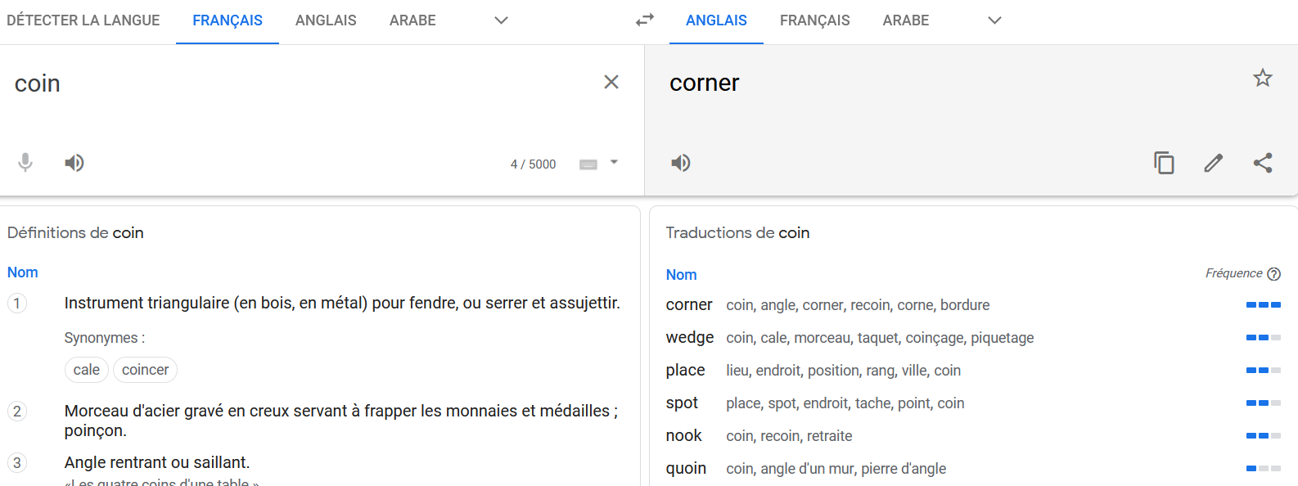
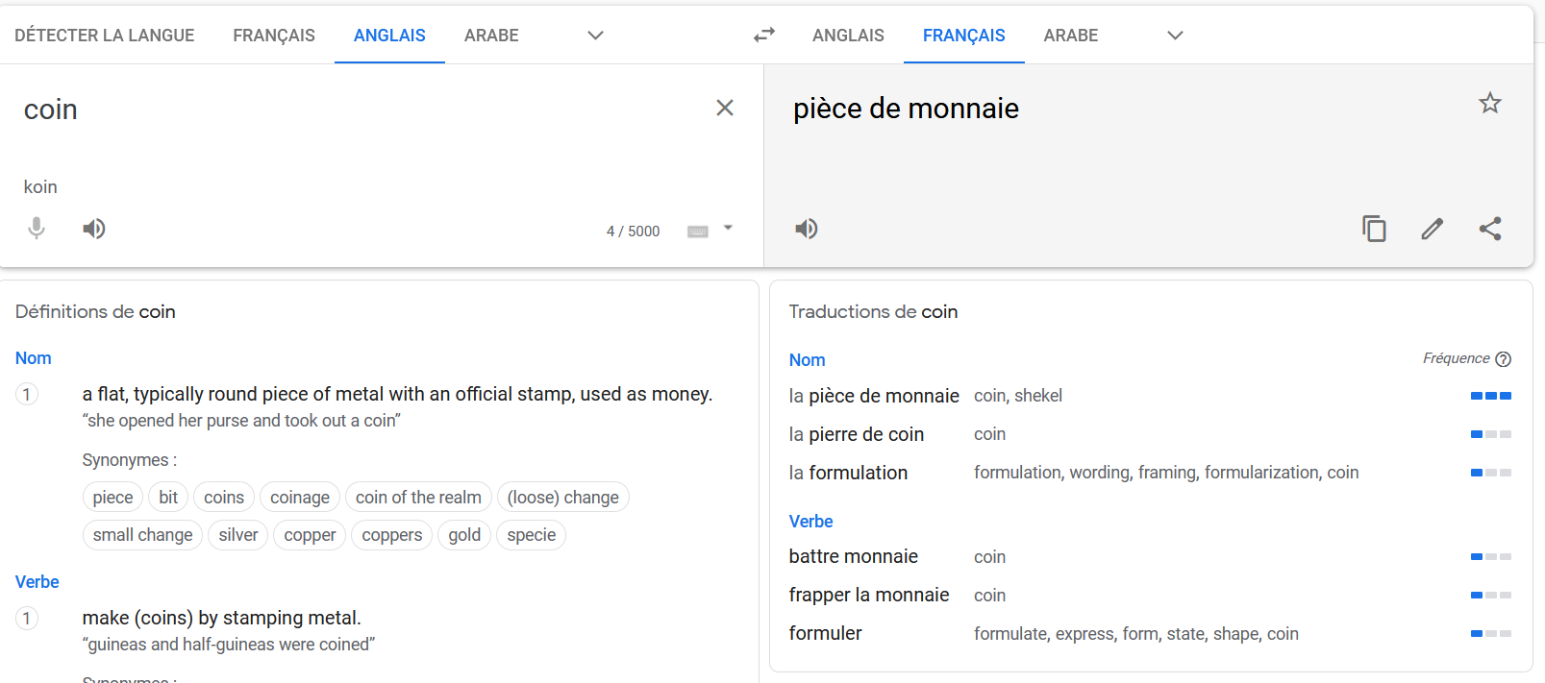
The embedding problem, in language
Problem #3: Identical words can have multiple meanings depending on the related task or language being used.
Words could have completely different meaning depending on language or task at hand (Law jargon? Medical jargon?)
Also, weird contexts like sarcasm, metaphors, memes, etc.!
Coin (FR) = Corner (ENG)
Coin (ENG) = Piece (FR)
Piece (FR) = Room (ENG)

Slide 42
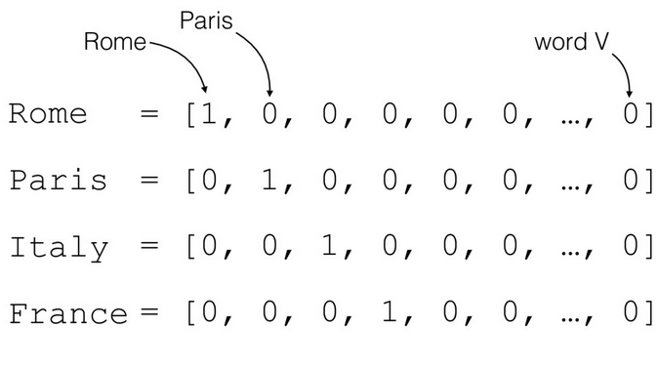
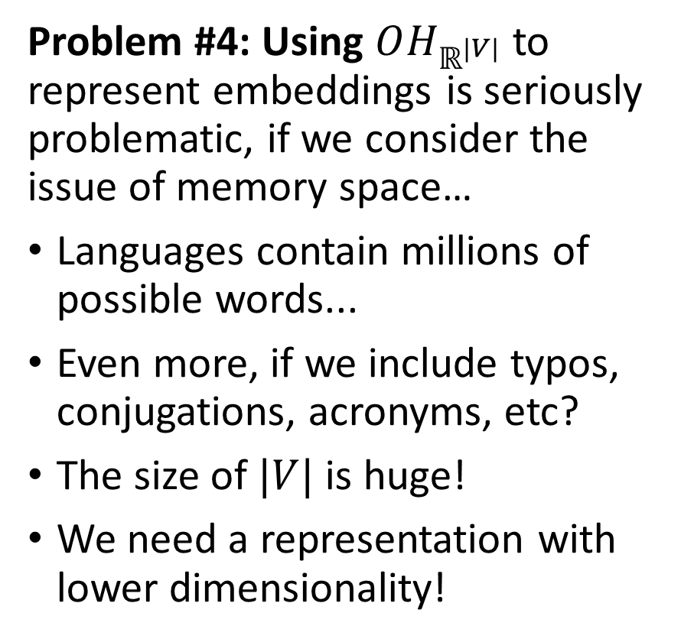
The embedding problem, in language
Problem #4: Using $OH_{ℝ^{|V|}}$ to represent embeddings is seriously problematic, if we consider the issue of memory space…
Languages contain millions of possible words...
Even more, if we include typos, conjugations, acronyms, etc?
The size of $|V|$ is huge!
We need a representation with lower dimensionality!
What is the size of this vector?!
How many zeros in there?!

Slide 43
The embedding problem, in language
We cannot really decide the embedding manually… Neither can we come up with an expert system for word embedding.
And what do we do, when something like that happens?
AS USUAL, LET AN AI FIGURE IT OUT FOR US!
Two possible approaches:
Frequency-based embeddings (nowadays, we do not really use those anymore, but feel free to have a look at TF-IDF and consorts)
Prediction-based embeddings (Let us get started with Continuous Bag of Words and Skip-Gram)

Slide 44
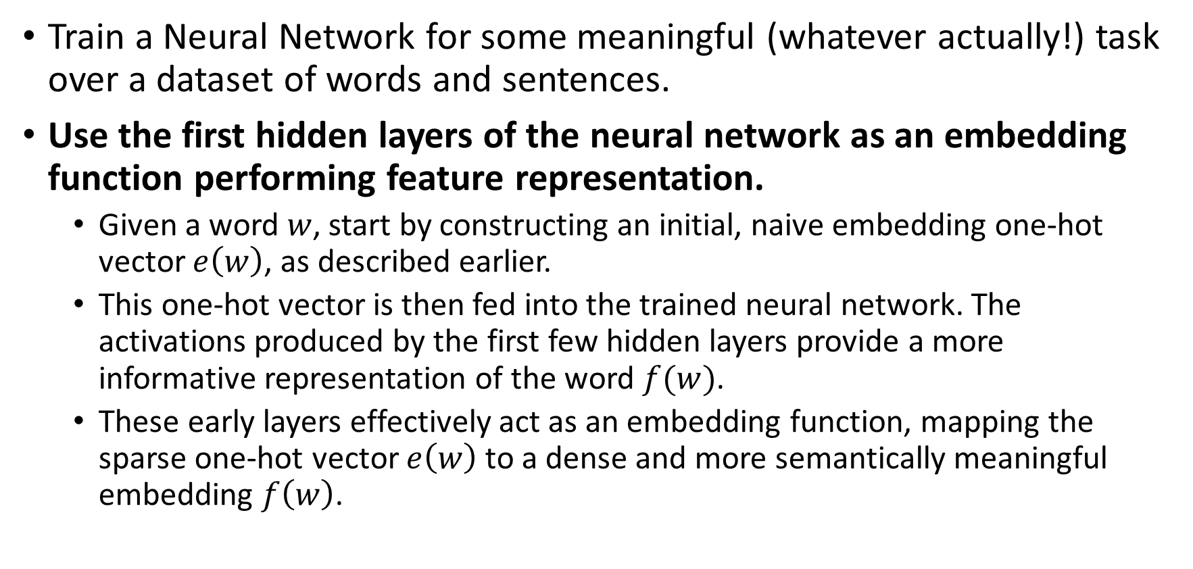
How to generate an embedding with AI?
Train a Neural Network for some meaningful (whatever actually!) task over a dataset of words and sentences.
Use the first hidden layers of the neural network as an embedding function performing feature representation.
Given a word $w$, start by constructing an initial, naive embedding one-hot vector $e\left(w\right)$, as described earlier.
This one-hot vector is then fed into the trained neural network. The activations produced by the first few hidden layers provide a more informative representation of the word $f(w)$.
These early layers effectively act as an embedding function, mapping the sparse one-hot vector $e\left(w\right)$ to a dense and more semantically meaningful embedding $f\left(w\right)$.

Slide 45
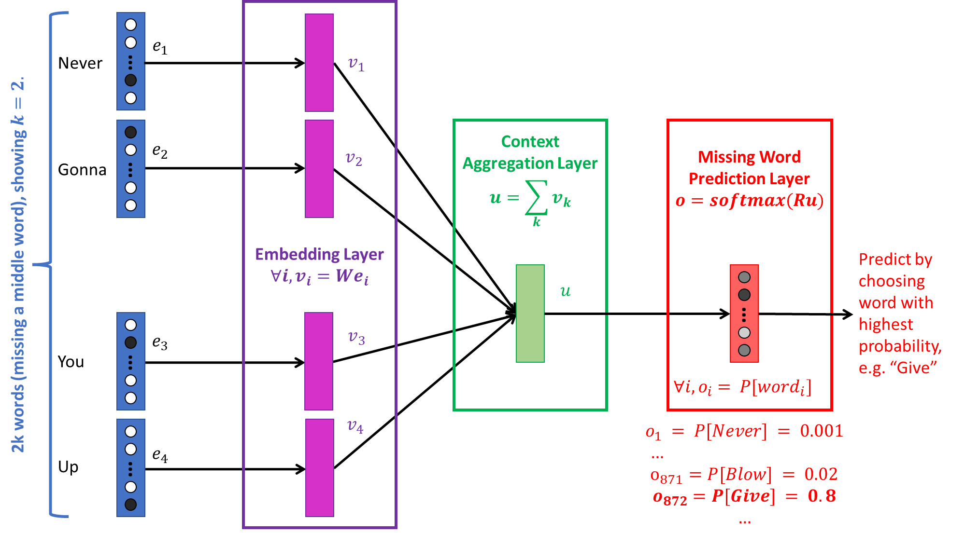
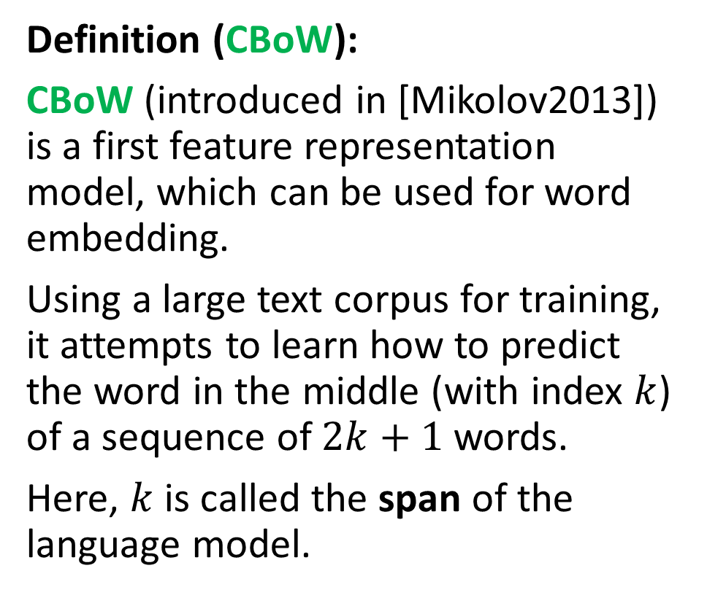
Continuous Bag of Words (CBoW)
Definition (CBoW):
CBoW (introduced in [Mikolov2013]) is a first feature representation model, which can be used for word embedding.
Using a large text corpus for training, it attempts to learn how to predict the word in the middle (with index $k$) of a sequence of $2k+1$words.
Here, $k$ is called the span of the language model.

Slide 46












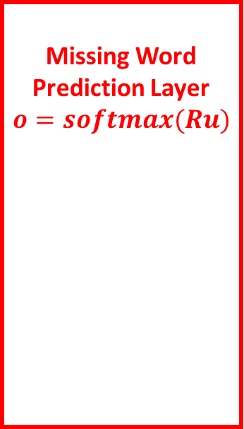
Embedding Layer
$$∀i, v_{i}=We_{i}$$
$$e_{1}$$
Never
…
$$v_{1}$$
Context Aggregation Layer
$$u=\sum_{k}{v_{k}}$$
Missing Word
Prediction Layer
$$o=softmax(Ru)$$
$$e_{2}$$
$$v_{2}$$
Gonna
…
2k words (missing a middle word), showing $k=2.$
Predict by choosing word with highest probability, e.g. “Give”
$$u$$
…
$$e_{3}$$
$$v_{3}$$
You
…
$${∀i, o}_{i} = P[word_{i}]$$
$$v_{4}$$
…
$$e_{4}$$
Up

Slide 47

Continuous Bag of Words (CBoW)
Consider the text: “I have a dream that one day this nation will rise up and live out the true meaning of its creed: We hold these truths to be self-evident, that all men are created equal. I have a dream that one day on the red hills of Georgia, the sons of former slaves and the sons of former slave owners will be able to sit down together at the table of brotherhood.”
0. We will use a sliding window, with e.g. size $k=2$, to generate pairs of $(x, y)$values to train our CBoW on.
$$x_{1}=\left(I, have,dream, that\right),$$
$$y_{1}=a$$

Slide 48

Continuous Bag of Words (CBoW)
Consider the text: “I have a dream that one day this nation will rise up and live out the true meaning of its creed: We hold these truths to be self-evident, that all men are created equal. I have a dream that one day on the red hills of Georgia, the sons of former slaves and the sons of former slave owners will be able to sit down together at the table of brotherhood.”
0. We will use a sliding window, with e.g. size $k=2$, to generate pairs of $(x, y)$values to train our CBoW on.
$$x_{1}=\left(I, have,dream, that\right),$$
$$y_{1}=a$$
$$x_{2}=\left(have,a, that,one\right),$$
$$y_{2}=dream$$

Slide 49

Continuous Bag of Words (CBoW)
Consider the text: “I have a dream that one day this nation will rise up and live out the true meaning of its creed: We hold these truths to be self-evident, that all men are created equal. I have a dream that one day on the red hills of Georgia, the sons of former slaves and the sons of former slave owners will be able to sit down together at the table of brotherhood.”
0. We will use a sliding window, with e.g. size $k=2$, to generate pairs of $(x, y)$values to train our CBoW on.
$$x_{1}=\left(I, have,dream, that\right),$$
$$y_{1}=a$$
$$x_{2}=\left(have,a, that,one\right),$$
$$y_{2}=dream$$
$$x_{72}=\left(the, sons, former, slave\right),$$
$$y_{72}=of$$

Slide 50

Continuous Bag of Words (CBoW)
Then, build a simple NN, which takes the 2k non-middle words, as one-hot embeddings $e_{i}∈ℝ^{\left|V\right|}$.
Add one embedding layer with matrix $W∈$ $ℝ^{D×\left|V\right|}$. Here, $D$ denotes the size of the new word embedding and is often chosen such that $D≪\left|V\right|$. Note: after training, $v_{k}=We_{k}$ will be used as the new word embedding to replace $e_{k}$!

Slide 51


Embedding Layer
$$∀i, v_{i}=We_{i}$$
1. Start by using one-hot encoding on your $2k$ input words
$∀i, e_{i}∈ℝ^{\left|V\right|}$, with $\left|V\right|$ being the dictionary size.
$$e_{1}$$
Never
…
$$v_{1}$$
Context Aggregation Layer
$$u=\sum_{k}{v_{k}}$$
Missing Word
Prediction Layer
$$o=softmax(Ru)$$
$$e_{2}$$
$$v_{2}$$
Gonna
…
2k words (missing a middle word), showing $k=2.$
Predict by choosing word with highest probability, e.g. “Give”
$$u$$
…
$$e_{3}$$
$$v_{3}$$
You
…
$${∀i, o}_{i} = P[word_{i}]$$
$$v_{4}$$
$$o_{1} = P[Never] = 0.001$$
$$… \\ o_{871}=P[Blow] = 0.02$$
$$o_{872}=P[Give] = 0.8$$
$$…$$
…
$$e_{4}$$
Up

Slide 52

Continuous Bag of Words (CBoW)
Then, build a simple NN, which takes the 2k non-middle words, as one-hot embeddings $e_{i}∈ℝ^{\left|V\right|}$.
Add one embedding layer with matrix $W∈$ $ℝ^{D×\left|V\right|}$. Here, $D$ denotes the size of the new word embedding and is often chosen such that $D≪\left|V\right|$. Note: after training, $v_{k}=We_{k}$ will be used as the new word embedding to replace $e_{k}$!

Slide 53


Embedding Layer
$$∀i, v_{i}=We_{i}$$
2. Apply the same dense/linear transformation to each $e_{i}.$
We have $∀i, v_{i}=We_{i}$, which is implemented by an embedding layer in PyTorch, with trainable parameter $W∈$ $ℝ^{\left|V\right|×D}$.
This produces lower dimensionality vector representations for words, i.e. $∀i, v_{i}∈ℝ^{D}$, with $D≪\left|V\right|$.
$$e_{1}$$
Never
…
$$v_{1}$$
Context Aggregation Layer
$$u=\sum_{k}{v_{k}}$$
Missing Word
Prediction Layer
$$o=softmax(Ru)$$
$$e_{2}$$
$$v_{2}$$
Gonna
…
2k words (missing a middle word), showing $k=2.$
Predict by choosing word with highest probability, e.g. “Give”
$$u$$
…
$$e_{3}$$
$$v_{3}$$
You
…
$${∀i, o}_{i} = P[word_{i}]$$
$$v_{4}$$
$$o_{1} = P[Never] = 0.001$$
$$… \\ o_{871}=P[Blow] = 0.02$$
$$o_{872}=P[Give] = 0.8$$
$$…$$
…
$$e_{4}$$
Up

Slide 54

Continuous Bag of Words (CBoW)
Definition (the Embedding Layer):
On the first matrix multiplication, we use an Embedding Layer, not a Linear one. In this layer, each of the $2k$ input one-hot vector of size $\left|V\right|$ is multiplied by the same matrix $W∈$ $ℝ^{D×\left|V\right|}$ to produce an embedding of size $D$.
This is important as this is our embedding function and we want it to be applied identically to each word in the $2k$ inputs!
$$W is D×\left|V\right|, not kD×2k\left|V\right|!$$
You can see this as a Linear layer being used with identical parameters on all one-hot embeddings, in parallel!

Slide 55

Continuous Bag of Words (CBoW)
Then, build a simple NN, which takes the 2k non-middle words, as one-hot embeddings $e_{i}∈ℝ^{\left|V\right|}$.
Add one embedding layer with matrix $W∈$ $ℝ^{D×\left|V\right|}$. Here, $D$ denotes the size of the new word embedding and is often chosen such that $D≪\left|V\right|$. Note: after training, $v_{k}=We_{k}$ will be used as the new word embedding to replace $e_{k}$!

Slide 56

Continuous Bag of Words (CBoW)
Then, build a simple NN, which takes the 2k non-middle words, as one-hot embeddings $e_{i}∈ℝ^{\left|V\right|}$.
Add one embedding layer with matrix $W∈$ $ℝ^{D×\left|V\right|}$. Here, $D$ denotes the size of the new word embedding and is often chosen such that $D≪\left|V\right|$. Note: after training, $v_{k}=We_{k}$ will be used as the new word embedding to replace $e_{k}$!
Note: having $D≪\left|V\right|$ is important, as it addresses the memory space issue (Problem #4) we discussed earlier.
(Problem #4: Using $OH_{ℝ^{|V|}}$ to represent embeddings is seriously problematic, if we consider the issue of memory space…)

Slide 57

Continuous Bag of Words (CBoW)
The second to last layer is simply summing all the surrounding words feature representations together, to produce a vector $u$ describing the context for the missing word!
$$u=\sum_{k}{v_{k}}$$
This context aggregation is not trainable and gives an “average” context carried by the surrounding words, which is used to predict the missing word in the final layer.

Slide 58

Embedding Layer
$$∀i, v_{i}=We_{i}$$
3. The aggregation layer combines the contextual meaning vectors $v_{i}$ together by simply summing them, i.e. $u=\sum_{k}{v_{k}}$.
This non-trainable layer produces a vector $u∈ℝ^{D}$, with $D≪\left|V\right|$, which roughly encapsulates the meaning of the entire incomplete sentence of $2k$ input words.
$$e_{1}$$
Never
…
$$v_{1}$$
Context Aggregation Layer
$$u=\sum_{k}{v_{k}}$$
Missing Word
Prediction Layer
$$o=softmax(Ru)$$
$$e_{2}$$
$$v_{2}$$
Gonna
…
2k words (missing a middle word), showing $k=2.$
Predict by choosing word with highest probability, e.g. “Give”
$$u$$
…
$$e_{3}$$
$$v_{3}$$
You
…
$${∀i, o}_{i} = P[word_{i}]$$
$$v_{4}$$
$$o_{1} = P[Never] = 0.001$$
$$… \\ o_{871}=P[Blow] = 0.02$$
$$o_{872}=P[Give] = 0.8$$
$$…$$
…
$$e_{4}$$
Up

Slide 59

Continuous Bag of Words (CBoW)
The final linear layer is trainable and produces an output $o$:
$$o=softmax(Ru)$$
With $R∈$ $ℝ^{\left|V\right|×D}$ so that $o∈ℝ^{\left|V\right|}$.
The output $o$then gives probabilities over which word should be predicted as the missing word, for each possible word in the dictionary of words $V$.

Slide 60

Embedding Layer
$$∀i, v_{i}=We_{i}$$
4. Use a dense/linear layer, with trainable parameter $R∈ℝ^{D×\left|V\right|}$, to predict the missing word, i.e. $o=softmax(Ru$).
The output $o∈$ $ℝ^{\left|V\right|}$ contains the probability of each word $i$ being the missing word in the incomplete input sentence, i.e.
$${∀i, o}_{i} = P[word_{i}]$$
$$e_{1}$$
Never
…
$$v_{1}$$
Context Aggregation Layer
$$u=\sum_{k}{v_{k}}$$
Missing Word
Prediction Layer
$$o=softmax(Ru)$$
$$e_{2}$$
$$v_{2}$$
Gonna
…
2k words (missing a middle word), showing $k=2.$
Predict by choosing word with highest probability, e.g. “Give”
$$u$$
…
$$e_{3}$$
$$v_{3}$$
You
…
$${∀i, o}_{i} = P[word_{i}]$$
$$v_{4}$$
$$o_{1} = P[Never] = 0.001$$
$$… \\ o_{871}=P[Blow] = 0.02$$
$$o_{872}=P[Give] = 0.8$$
$$…$$
…
$$e_{4}$$
Up

Slide 61

Continuous Bag of Words (CBoW)
During the training, we browse through all the pairs $(x,y)$we generated on Step 0. Classification loss: use some sort of a negative logarithm as the loss function, i.e.
$$L_{t}=−\log\left(o_{t}=e_{t}\right|e_{−t})$$
With
$${e_{−t= }(e}_{t−k},…e_{t−1},e_{t+1},…,e_{t+k)}$$
And sum over all the pairs $\left(x,y\right)$.

Slide 62
Continuous Bag of Words (CBoW)
Important Notes
There are variations on this, as explained in [Mikolov2014].
For instance, predict the word at the end of the context, instead of the middle.

Slide 63

Continuous Bag of Words (CBoW)
Important Notes
There are variations on this, as explained in [Mikolov2014].
For instance, predict the word at the end of the context, instead of the middle.
(Similar to a predictive keyboard on your phone?)

Slide 64
Continuous Bag of Words (CBoW)
Important Notes
There are variations on this, as explained in [Mikolov2014].
For instance, predict the word at the end of the context, instead of the middle.
We could also remove non-meaningful words (“a”, “an”, “the”, etc.) during Step 1 to help the word embedding task not get lost in meaningless context.

Slide 65
Why does that work?
The TGV was really crowded, because it was around Christmas time.
I jumped on the TGV and three hours later I was in Paris.
The French TGV is super fast, a close second to the Japanese Shinkansen when it comes to raw speed.
Can you understand what TGV might be, based on these sentences? Why?
Definition (the distributional hypothesis of linguistics):
We may rely on a fundamental linguistic assumption → Words appearing in similar contexts/sentences tend to be related to each other.
This is a central hypothesis and is commonly referred to as the distributional hypothesis of linguistics.

Slide 66


Why does that work?
Can you understand what TGV might be, based on these sentences? Why?
Definition (the distributional hypothesis of linguistics):
We may rely on a fundamental linguistic assumption → Words appearing in similar contexts/sentences tend to be related to each other.
This is a central hypothesis and is commonly referred to as the distributional hypothesis of linguistics.

Slide 67
Why does that work?
The TGV was really crowded, because it was around Christmas time.
I jumped on the TGV and three hours later I was in Paris.
The French TGV is super fast, a close second to the Japanese Shinkansen when it comes to raw speed.
Can you understand what TGV might be, based on these sentences? Why?
Because you deduced the meaning of this missing word using surrounding words to gather some context.
CBoW does the same thing (kind of)!
Definition (the distributional hypothesis of linguistics):
We may rely on a fundamental linguistic assumption → Words appearing in similar contexts/sentences tend to be related to each other.
This is a central hypothesis and is commonly referred to as the distributional hypothesis of linguistics.

Slide 68
Why does that work?
Definition (the distributional hypothesis of linguistics – full version):
Similarity in linguistics does not simply mean having similar orthographic representations.
Instead, we may rely on a fundamental linguistic assumption → Words appearing in similar contexts/sentences are related.
This is a central hypothesis and is commonly referred to as the distributional hypothesis of linguistics.
CBoW is therefore a technique, which aims at defining meaning for words (in the form of an embedding vector), by using this hypothesis, therefore establishing connections between words in texts. In solving this task, CBoW produces meaningful embeddings in its first few layers.

Slide 69
Time for a quick demo of CBoW
Notebooks 1. and 1bis.

Slide 70
Conclusion (W8S1)
We have seen a few approaches to embeddings.
Ideally, they should be bijective, but impossible for NLP.
Manually embedding is often better but often impossible, typically in NLP.
Train an AI to figure out embeddings?
CBoW
(SkipGram, next time)
A few more problems are still open at the moment for these word embeddings.
Can we improve these embeddings and use more advanced techniques?
How to deal with out of vocabulary words? (If we have never seen the word, how do we represent it as a one-hot vector to begin with?)

Slide 71
Learn more about these topics
Out of class, for those of you who are curious
[Mikolov2013] Mikolov et al., “Efficient Estimation of Word Representations in Vector Space”, 2013. https://arxiv.org/abs/1301.3781
[Mikilov2014] Mikolov et al., “Distributed Representations of Words and Phrases and their Compositionality”, 2014 https://arxiv.org/abs/1310.4546

Slide 72
Learn more about these topics
Tracking important names (Track their works and follow them on Scholar, Twitter, or whatever works for you!)
Tomas Mikolov: Research Scientist at Czech Institute of Informatics, Robotics and Cybernetics. Former Researcher at Facebook and Google Brain. https://scholar.google.com.sg/citations?user=oBu8kMMAAAAJ&hl=en https://www.ciirc.cvut.cz/svetove-uznavany-expert-tomas-mikolov-prichazi-z-facebook-ai-do-ciirc-cvut-zameri-se-na-vyvoj-silne-umele-inteligence/

Slide 73

Embeddings, a mathematical definition
Theorem #2 (bijective functions and domain/codomain size):
Consider two countable sets, $X$ and $X′$.
(Countable sets are sets whose elements could be counted, or labeled as 1, 2, 3,…)
If there exists a bijective function $f: X→X′$, then $X$ and $X’$have the same cardinality, i.e. the same number of elements.

